Slide 1

Electric Circuits

Slide 2
Circuits
Activator
Notes:
Instructional Approach(s): The teacher should use the slide to activate students prior knowledge.(on resource page)

Slide 3
Essential Question:
How are series and parallel circuits similar and different in how they transfer energy?
Standard:
S8P5b. Demonstrate the advantages and disadvantages of series and parallel circuits and how they transfer energy
Notes:
Instructional Approach(s): The teacher should introduce the essential question and the standard that aligns to the essential question

Slide 4
Review:
Turn to a seat partner and discuss the meaning of: electric charge
and electricity
Notes:
Instructional Approach(s): The teacher can pose the questions to the class and let the students pair up to answer the questions. The teacher should not spend more than a few minutes on the slide. When ready, the teacher can click the mouse to show the answers. The teacher should present the information on the slide while the students record the important information on their notes

Slide 5
Electric Charge: Objects become positively charged when they lose electrons and negatively charged when they gain electrons; objects with like charges repel and objects with opposite charges attract
Electricity: the presence and/or flow of electric charges
Notes:
Instructional Approach(s): The teacher should present the information on the slide while the students record the important information on their notes

Slide 6
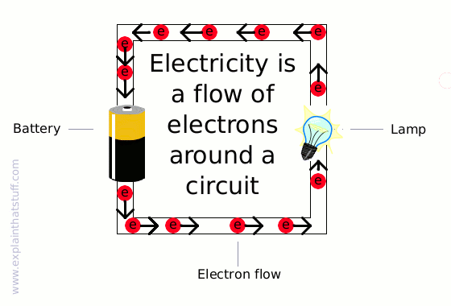
Notes:
Instructional Approach(s): The teacher should present the information on the slide while the students record the important information on their notes

Slide 7
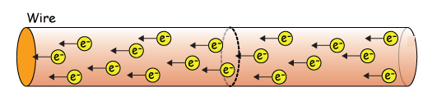
All matter is composed of positive and negative particles.
The flow of charged particles
is an electric current.
Notes:
Instructional Approach(s): The teacher should present the information on the slide while the students record the important information on their notes

Slide 8



When you watch TV, use a computer, or even turn on a light, you depend on moving charges for the electrical energy that you need.
Notes:
Instructional Approach(s): The teacher should present the illustration on the slide to provide everyday life examples of electrical energy and currents

Slide 9
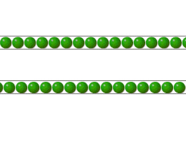
Higher Current = Faster Moving Electric Charges (Electrons)
Notes:
Instructional Approach(s): The teacher should present the information on the slide while the students record the important information on their notes

Slide 10

Electric Currents are like roller coasters.
They follow a fixed pathway.
Notes:
Instructional Approach(s): The teacher should present the illustration on the slide to provide everyday life examples of electrical currents

Slide 11
Electric Circuits
Circuits control the movement of electric current by providing paths for electrons to follow.
The path of an electric circuit is a closed loop.
Notes:
Instructional Approach(s): The teacher should present the information on the slide while the students record the important information on their notes

Slide 12
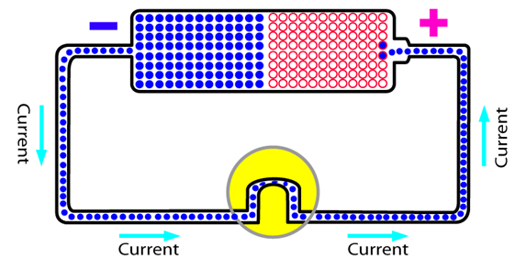
Electric Circuits
An electric circuit allows electrons to flow from a negative pole (excess electrons) to a positive pole (deficient in electrons)
Notes:
Instructional Approach(s): The teacher should present the information on the slide while the students record the important information on their notes

Slide 13
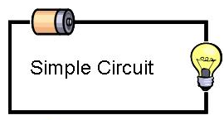
Electric Circuits
All circuits need three basic parts: an energy source, wires, and the object that is going to change the electrical energy into another form of energy (load).
Energy Source
Wire
Load
Notes:
Students do not have to know load specifically, but it is easier to say load instead of always saying “object that converts the electrical energy into other forms”

Slide 14
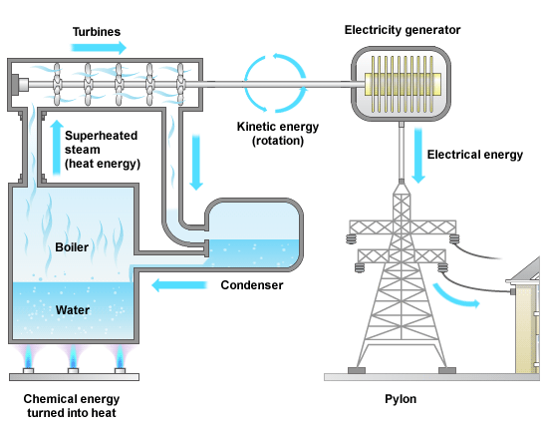

Energy Source Examples
Battery
Power Plant Generator
Notes:
Instructional Approach(s): The teacher should present the illustration on the slide to provide examples of energy sources

Slide 15





Load Examples
Changes electrical energy to other forms of energy
Car
Light Bulb
Speaker
Fan
Toaster
Notes:
Have students identify other possible loads.

Slide 16
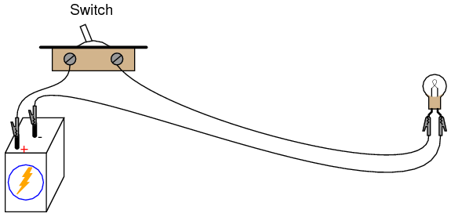
Electric Circuits
Sometimes a circuit also contains a switch that is used to open and close a circuit.
http://tdflashzone.net23.net/index.php?p=2_37
Notes:
Instructional Approach(s): The teacher should present the illustration and link on the slide to provide examples of switches

Slide 17
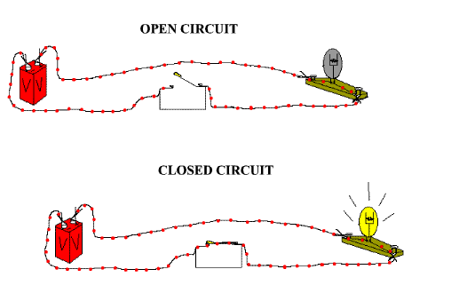
Electric Circuits
Notes:
Instructional Approach(s): The teacher should present the illustration on the slide to provide examples of open and closed circuits

Slide 18
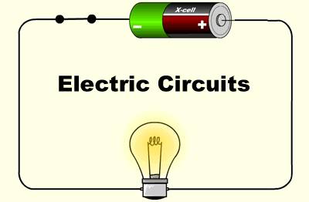
Connections in a Circuit
Electrons flow from negative to positive; therefore, a complete circuit must have wires that connect the negative pole of the energy source to the positive pole of the energy source.
The circuit is established when there is a continuous path for electricity to travel from one end of the energy source to the other end.
Notes:
Instructional Approach(s): The teacher should present the information on the slide while the students record the important information on their notes

Slide 19
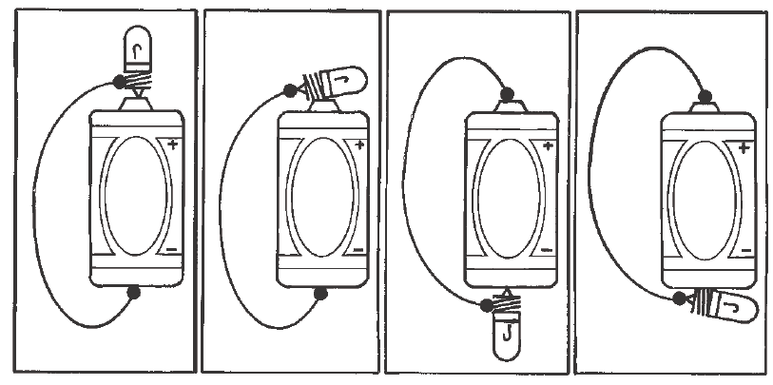
The illustrations below show four ways in which a simple circuit can be made.
Notes:
Instructional Approach(s): The teacher should present the illustration on the slide to provide examples of ways circuits can be made

Slide 20
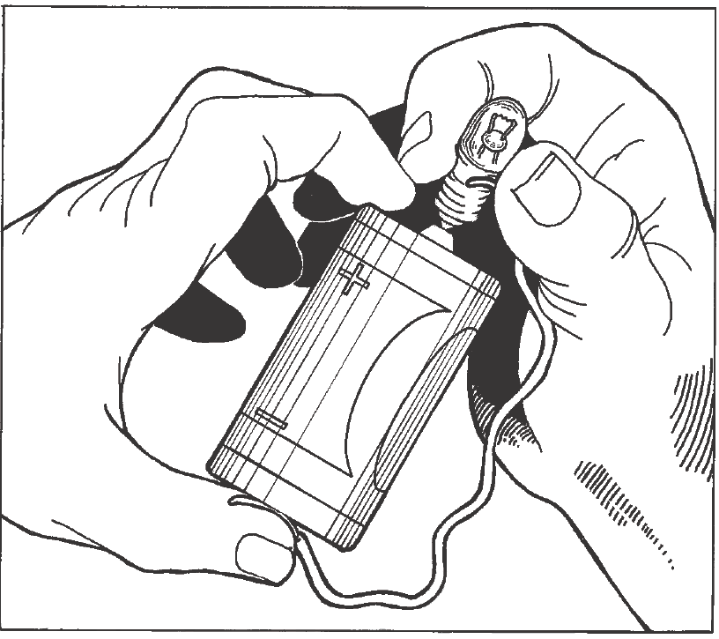
Make a Simple Circuit
Notes:
Instructional Approach(s): The teacher can use this slide to introduce making a simple circuit activity. (on resource page)

Slide 21
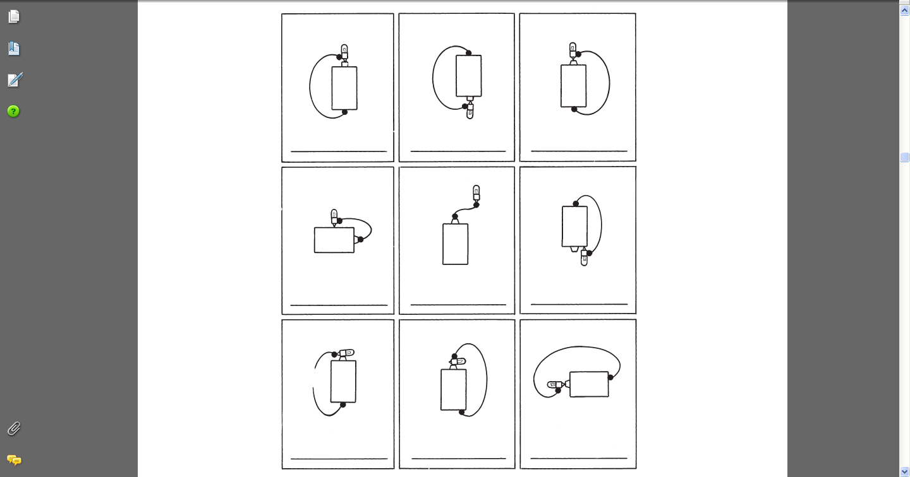
With a partner, determine whether the light bulbs in the following images will be On or Off based on the circuit connections. Be able to explain your answer.
On
On
On
Off
Off
Either
Off
Off
On
-
Notes:
Instructional Approach(s): The teacher can pose the questions to the class and let the students pair up to answer the questions. The teacher should not spend more than a few minutes on the slide. When ready, the teacher can click the mouse to show the answers. The teacher should present the information on the slide while the students record the important information on their notes

Slide 22
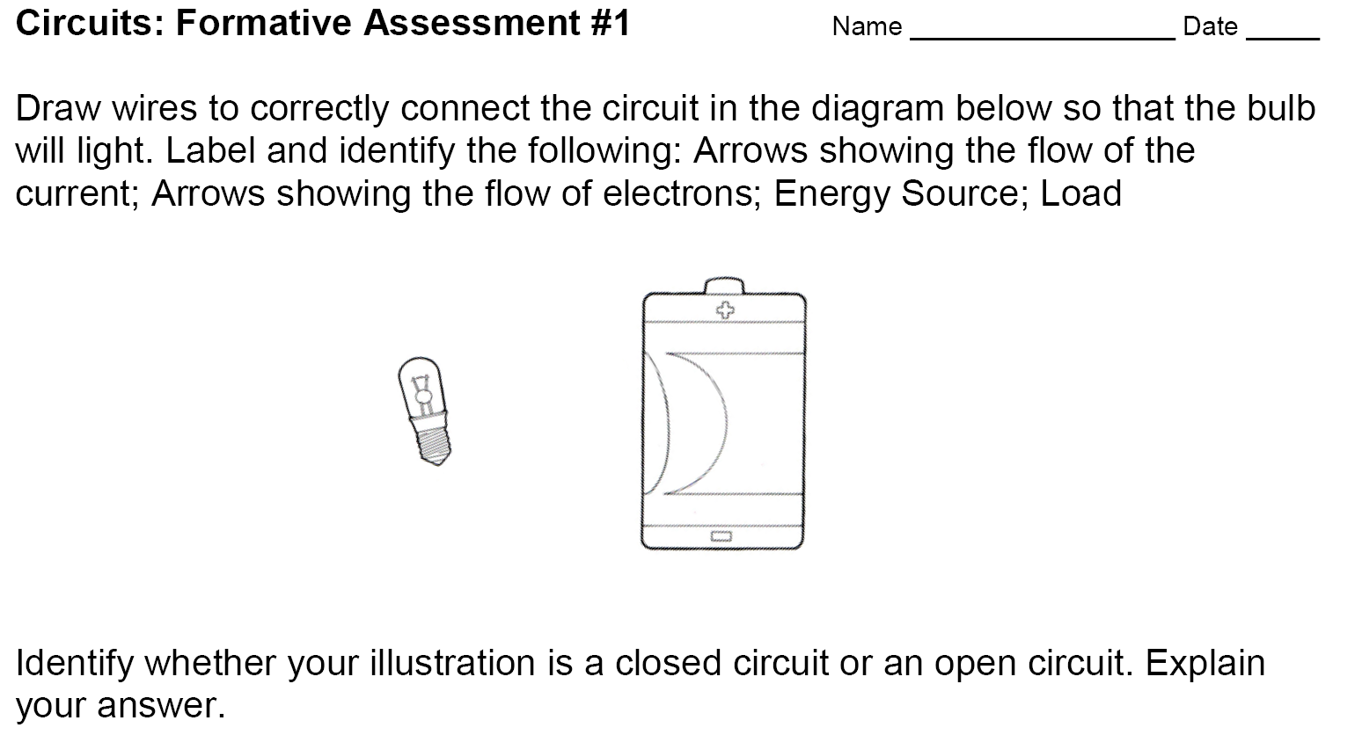
Formative Assessment
Notes:
Instructional Approach(s): Formative assessment. Each student should complete the assessment. The teacher should use the assessment to determine the level of student mastery and if differentiation is needed.

Slide 23
Bill Nye
Electric Circuits
Notes:
Instructional Approach(s): The teacher should present the video on the slide to reinforce circuits

Slide 24
Electric Circuits
With a partner, look around the room and identify all of the objects that use electrical energy.
All of the things you counted are loads in a large circuit. Most circuits have more than one load.
Notes:
Instructional Approach(s): The teacher can pose the questions to the class and let the students pair up to answer the questions. The teacher should not spend more than a few minutes on the slide.

Slide 25
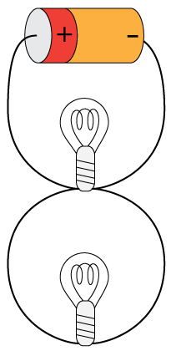
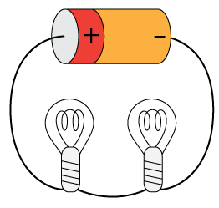
Different Types of Circuits
Circuits are distinguished based on the way in which loads are connected.
Notes:
Instructional Approach(s): The teacher should present the information on the slide while the students record the important information on their notes

Slide 26
Different Types of Circuits
With a partner, discuss the differences in which the electric current will travel
Notes:
Instructional Approach(s): The teacher can pose the questions to the class and let the students pair up to answer the questions. The teacher should not spend more than a few minutes on the slide. When ready, the teacher can answer the questions

Slide 27
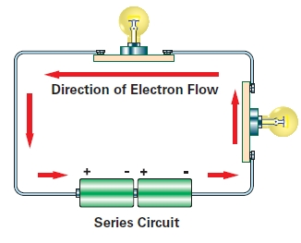
Series Circuit
In a Series Circuit there is only one path for the electric current or electricity to flow.
Notes:
Instructional Approach(s): The teacher should present the information on the slide while the students record the important information on their notes

Slide 28
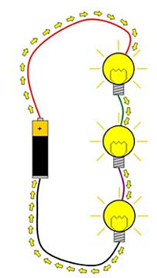
Series Circuit
All of the loads in a
series circuit share the same current.
If there is any break
in the circuit, the charges will stop flowing.
Notes:
Instructional Approach(s): The teacher should present the information on the slide while the students record the important information on their notes

Slide 29


Series Circuit
Imagine if your refrigerator and a lamp were in a series circuit together. Your refrigerator would run only when the lamp was on. And when the bulb burns out, the refrigerator would stop working.
Notes:
Instructional Approach(s): The teacher can pose the questions to the class or individual students to answer the questions. The teacher should not spend more than a few minutes on the slide.

Slide 30
Series Circuit
There are some cases when a series circuit is useful. For example, series circuits are useful in wiring burglar alarms. Why?
If any part of the circuit in a burglar alarm fails, there will be no current in the system. The lack of current signals that a problem exists, and the alarm will sound.
Can you think of any other examples?
Notes:
Instructional Approach(s): The teacher can pose the questions to the class or individual students to answer the questions. The teacher should not spend more than a few minutes on the slide. Students should record the advantage in their notes.

Slide 31

Imagine that your house is wired in a series circuit.
What would have to happen if you wanted to watch TV?
You would have to turn on other appliances in order to watch TV.
Stupid right?
Circuits in buildings are wired in Parallel.
Notes:
Instructional Approach(s): The teacher can pose the questions to the class or individual students to answer the questions. The teacher should not spend more than a few minutes on the slide. When ready, the teacher can click the mouse to show the answers.

Slide 32
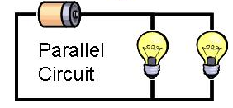
Parallel Circuit
In a Parallel Circuit there is more than one path for the electric current or electricity to flow.
Notes:
Instructional Approach(s): The teacher should present the information on the slide while the students record the important information on their notes

Slide 33
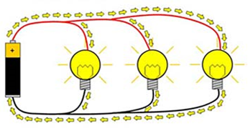
Parallel Circuit
The electric current branches so that electrons flow through each of the paths
If one path is broken, electrons continue to flow to the other paths
Notes:
Instructional Approach(s): The teacher should present the information on the slide while the students record the important information on their notes

Slide 34
Circuit Sort Activity
Notes:
Instructional Approach(s): The teacher should present the slide to introduce the circuit sort activity. (on resource page)

Slide 35
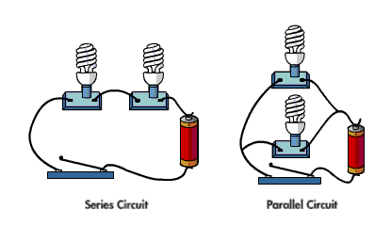
Comparing Series & Parallel
http://oviattfamily.net/electricity/flash/simpleCircuit.swf
Notes:
Instructional Approach(s): The teacher should present the information on the slide to provide comparisons between series and parallel circuits

Slide 36
Comparing Series & Parallel
What are the advantages of using a parallel circuit to a series circuit.
The load in a parallel circuit will still work if one of the loads is broken or missing. You can use one load at a time, even it another load fails.
Notes:
Instructional Approach(s): The teacher should present the information on the slide to provide comparisons between series and parallel circuits

Slide 37
Comparing Series & Parallel
Watch the online simulation comparing Series and Parallel circuits.
http://www.media.pearson.com.au/schools/cw/au_sch_rickard_sw2_1/int/circuits.html
Step 1 Teachers: Adjust only the voltage of each diagram.
Students, based on your observations, what do you think Voltage means? [see next slide]
Notes:
Instructional Approach(s): The teacher should present the information on the slide to provide comparisons between series and parallel circuits

Slide 38
Comparing Series & Parallel
Watch the online simulation comparing Series and Parallel circuits.
Voltage is the potential difference between two points in a circuit.
As voltage increases, more electrical potential energy is available to be changed into other forms of energy.
Basically, higher voltage means a faster flow of electrons or electric current.
Notes:
Instructional Approach(s): The teacher should present the information on the slide to provide comparisons between series and parallel circuits

Slide 39
Comparing Series & Parallel
Watch the online simulation comparing Series and Parallel circuits.
http://www.media.pearson.com.au/schools/cw/au_sch_rickard_sw2_1/int/circuits.html
Step 2 Teachers: Reduce the voltage back to 1.5v. Slowly increase and decrease the number of globes for each type of circuit.
Students, what do you observe?
Notes:
Instructional Approach(s): The teacher should present the information on the slide to provide comparisons between series and parallel circuits

Slide 40
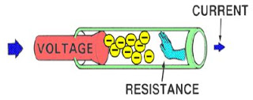
Comparing Series & Parallel
In a Series circuit, the current has to travel through each bulb; therefore, adding more light bulbs makes each bulb dimmer because the resistance of the whole circuit has increased.
Resistance is how difficult it is for electrons
to flow through a material (friction).
Notes:
Instructional Approach(s): The teacher should present the information on the slide to provide comparisons between series and parallel circuits

Slide 41
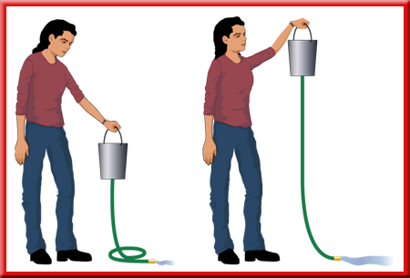
Think of the relationship between Electric Current, Voltage, and Resistance as shown in the diagram below.
As the bucket is raised, potential energy is increased (increase in voltage) and there is less resistance (friction) in the hose; therefore the flow of water (electric current) is greater.
Notes:
Instructional Approach(s): The teacher should present the illustration on the slide to provide an example of the relationship between currents, voltage, and resistance

Slide 42
Comparing Series & Parallel
Another advantage of a Parallel circuit is that you can connect loads that need different currents to the same parallel circuit.
For example, you can connect a hair dryer, which needs a high current to run, to the same circuit as a lamp,
which needs less current to run.
Notes:
Instructional Approach(s): The teacher should present the information on the slide to provide comparisons between series and parallel circuits

Slide 43
Circuit Activities
Pumped Up Circuits Song
Design a Circuit Board
Build Series and Parallel Circuits [see resources for examples]
Notes:
Instructional Approach(s): Link and activities on resource page (optional)

Slide 44
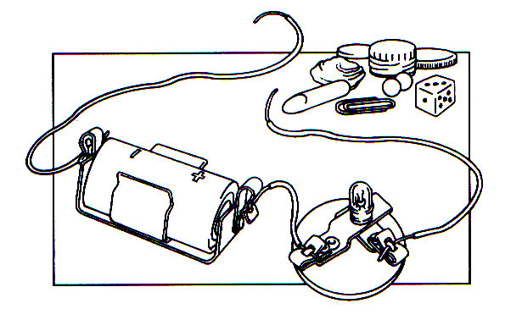
Look at the picture below. What does it mean if the bulb lights when you touch the wire to the ends of the paper clip?
What about one of the other items like a piece of chalk?
Notes:
Instructional Approach(s): The teacher can pose the questions to the class or individual students to answer the questions. The teacher should not spend more than a few minutes on the slide.

Slide 45
Recall that an electrical conductor
is a material in which charges can move easily (electrons flow freely).
An electrical insulator is a material in which charges cannot move easily (their electrons cannot flow freely).
Notes:
Instructional Approach(s): Review conductors and insulators

Slide 46
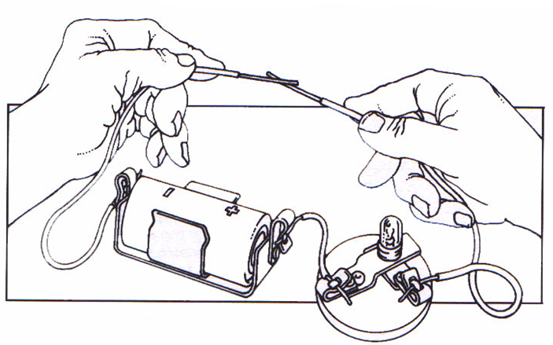
An open circuit can be used to test whether an object is a conductor or an insulator.
Notes:
Instructional Approach(s): The teacher use this slide to introduce assessment

Slide 47
Look at objects on the next two slides and identify whether the object is a conductor or insulator.
Notes:
Instructional Approach(s): Formative assessment. Each student should complete the assessment. The teacher should use the assessment to determine the level of student mastery and if differentiation is needed.

Slide 48
Can electricity flow through this material? |  | HYPOTHESIS |  | ACTUAL RESULTS (Conductor or Insulator?)
 |  | YES | NO
1 | Golf Tee
2 | Straw
3 | Brass Screw
4 | Paper Clip
5 | Aluminum Screen
6 | Plastic Screen
7 | Chalk
Insulator
Insulator
Conductor
Conductor
Conductor
Insulator
Insulator

Slide 49
Can electricity flow through this material? | HYPOTHESIS |  | ACTUAL RESULTS (Conductor or Insulator?)
 | YES | NO
Lead to lead-conductor
Wood- Insulator
8 | Pencil
9 | Brass Paper Fastener (brad)
10 | Finishing Nail
11 | Aluminum Nail (flat head)
12 | Marble
13 | Pipe Cleaner
14 | Copper Wire
15 | Aluminum Rod
Conductor
Conductor
Conductor
Insulator
Metal to metal -conductor
Brush- Insulator
Conductor
Conductor

Slide 50
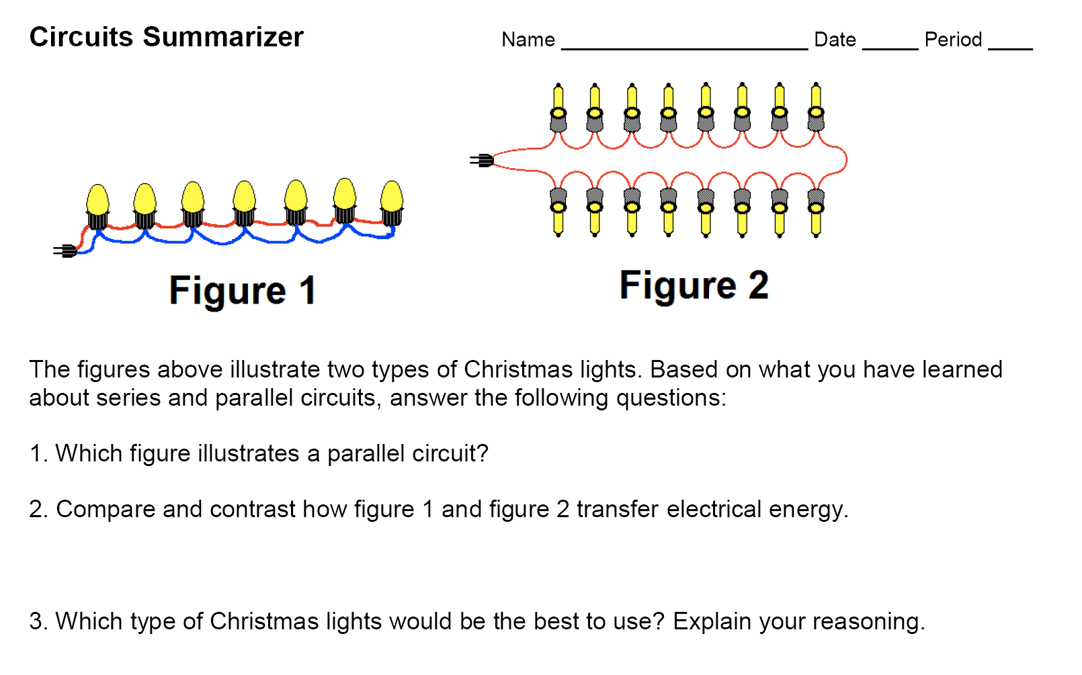
Notes:
Instructional Approach(s): Formative assessment. Each student should complete the summarizer. The teacher should use the summarizer to determine the level of student mastery and if differentiation is needed.

