Slide 1
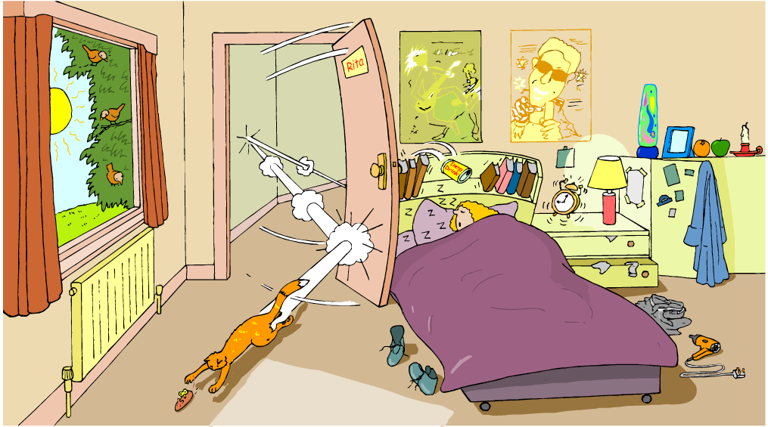
Identify all the forms of energy you see in the picture below.
Notes:
Instructional Approach(s): The teacher should use the slide to activate students prior knowledge. The teacher can pose the questions to the class, individual students, or let the students pair up to answer the questions. The teacher should not spend more than 5 minutes on discussing the slide.

Slide 2
Essential Question:
How are forms of energy alike and different?
Standards:
S8P2c. Compare and contrast the different forms of energy (heat, light, electricity, mechanical motion, sound) and their characteristics.
S8P2a. Explain that energy transformation in terms of the Law of Conservation of Energy.
Notes:
Instructional Approach(s): The teacher should introduce the essential question and the standard that aligns to the essential question

Slide 3

Notes:
Instructional Approach(s): The teacher should allow students to scan the QR Code if desired to follow along or review the ppt at a later date.

Slide 4
In our previous lesson, we learned that there are two types of energy: Potential Energy & Kinetic Energy
There are also many forms of energy. This lesson will provide an overview of some forms of energy. These forms of energy will be taught more indepth in later lessons.
Notes:
Instructional Approach(s): The teacher should present the information on the slide.

Slide 5
There are many forms of energy, but we are going to focus on just a few.
Heat energy (Thermal)
Mechanical energy
Light (Radiant) energy
Electrical energy
Sound energy
Chemical energy
Notes:
Instructional Approach(s): The teacher should present the information on the slide.

Slide 6
Use Your Graphic Organizer to
Record Important Information
Notes:
Instructional Approach(s): The teacher should give each student a copy of the Forms of Energy Graphic Organizer [linked on the resource page] to record important information during the lesson.

Slide 7
Heat (Thermal) Energy
Energy that is created in the movement of particles (atoms) that produces heat.
Heat (thermal) energy increases as temperature increases
The faster the particles (atoms) move, the greater the kinetic energy and the greater the object’s thermal energy. The opposite is also true.
Thermal energy also depends on the number of particles. If there are more particles, there is more thermal energy.
Notes:
Instructional Approach(s): The teacher should present the information on the slide while the students record the important information on their graphic organizer.

Slide 8
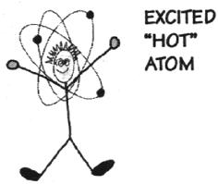
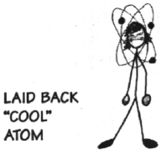
Heat (Thermal) Energy
A hot object is one whose atoms and molecules are excited and show rapid movement.
(More heat energy)
A cooler object's molecules and atoms will show less movement. (Less heat energy)
Notes:
Instructional Approach(s): The teacher should use the images on the slide to illustrate examples of molecular movement for heat.

Slide 9
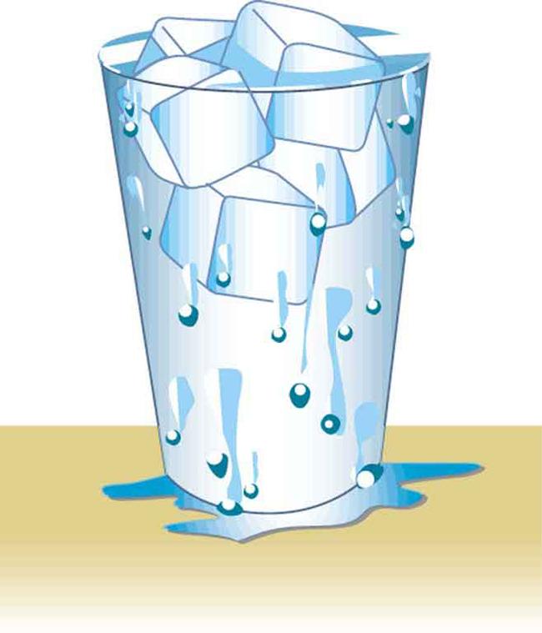
Which has more thermal energy? Why?
Hot Chocolate
Ice Water
Notes:
Instructional Approach(s): The teacher should use the images on the slide to illustrate examples of thermal energy.

Slide 10

Mechanical
Energy
Energy of motion
The total energy of motion and
position of an object
(potential energy + kinetic energy)
Mechanical energy can be all
potential energy, all kinetic
energy, or some of each.
Notes:
Instructional Approach(s): The teacher should present the information on the slide while the students record the important information on their graphic organizer.

Slide 11

Mechanical Energy
The mechanical energy of an
object stays the same, but the
potential and kinetic energy of
an object can increase or decrease.
Think of juggling. The kinetic energy decreases until all of the pin’s kinetic energy turns into potential energy, and it stops moving upward.
As the pin falls back down again, its potential energy starts changing back into kinetic energy.
Notes:
Instructional Approach(s): The teacher should present the information on the slide while the students record the important information on their graphic organizer.

Slide 12
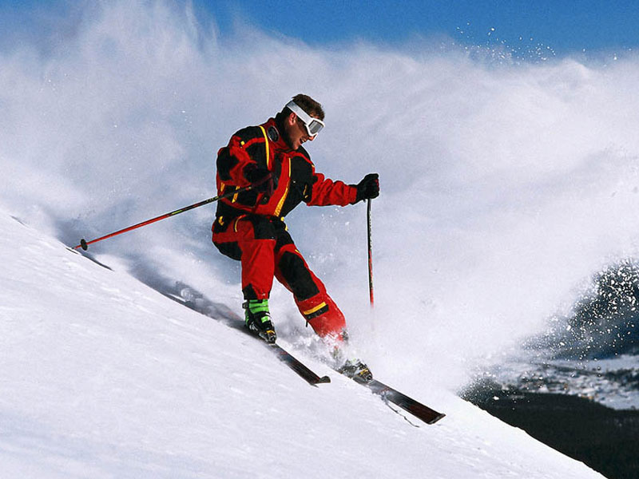
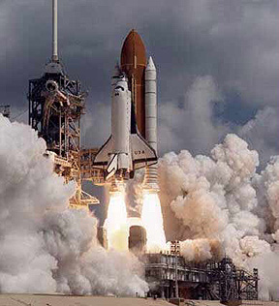

Examples of Mechanical Energy
Notes:
Instructional Approach(s): The teacher should use the images on the slide to illustrate examples of mechanical energy.

Slide 13
Light (Radiant) Energy
Energy created by vibrating particles that create waves that travel through space and time. [These waves are called electromagnetic waves.]
Light (Radiant) energy can be absorbed, transmitted, or reflected.
Includes energy from gamma rays, x-rays, ultraviolet rays, visible light, infrared rays, microwave and radio bands
Notes:
Instructional Approach(s): The teacher should present the information on the slide while the students record the important information on their graphic organizer.

Slide 14
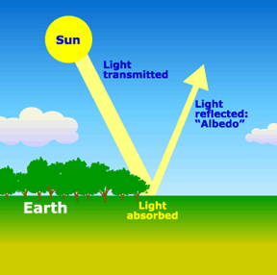
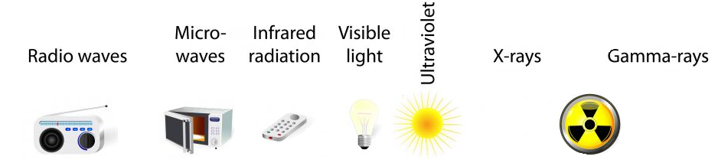
Examples of Light (Radiant) Energy
Notes:
Instructional Approach(s): The teacher should use the images on the slide to illustrate examples of light energy.

Slide 15
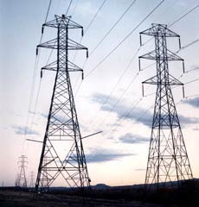
Electrical Energy
Energy that is carried by an electrical current (the movement of electrons, the negatively charged particles of atoms)
The electrical energy used in your home can be thought of as potential energy that is used when you plug in an electrical appliance and use it.
Notes:
Instructional Approach(s): The teacher should present the information on the slide while the students record the important information on their graphic organizer.

Slide 16
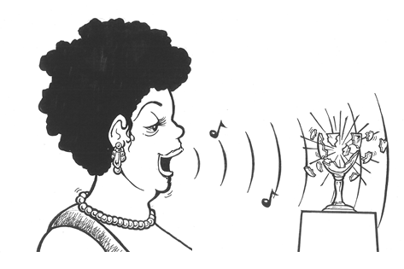
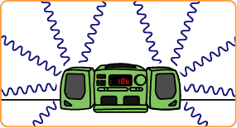
Sound Energy
Sound energy is caused by an object’s vibrations
A vibrating object transmits energy through the air around it in waves (longitudinal waves)
Notes:
Instructional Approach(s): The teacher should present the information on the slide while the students record the important information on their graphic organizer.

Slide 17
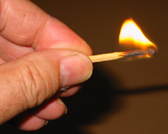
Chemical Energy
Energy stored in chemical bonds
When chemical bonds are broken, new chemicals are formed and some of it is released energy
Examples: Food, Battery, Burning candle or Wood, Fireworks, Fossil Fuels, Gasoline
Notes:
Instructional Approach(s): The teacher should present the information on the slide while the students record the important information on their graphic organizer.

Slide 18
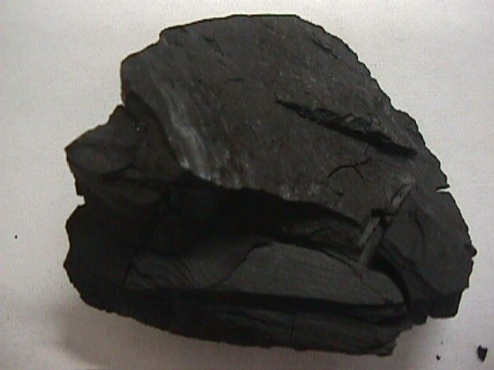
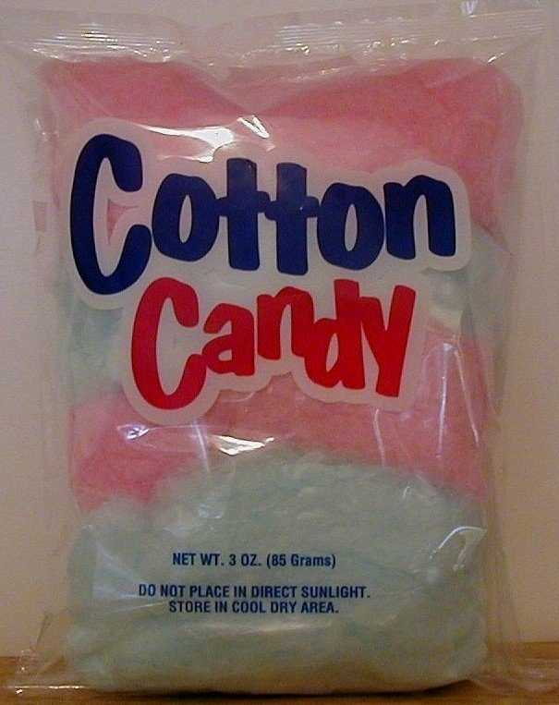

Examples of Chemical Energy
Notes:
Instructional Approach(s): The teacher should use the images on the slide to illustrate examples of chemical energy.

Slide 19
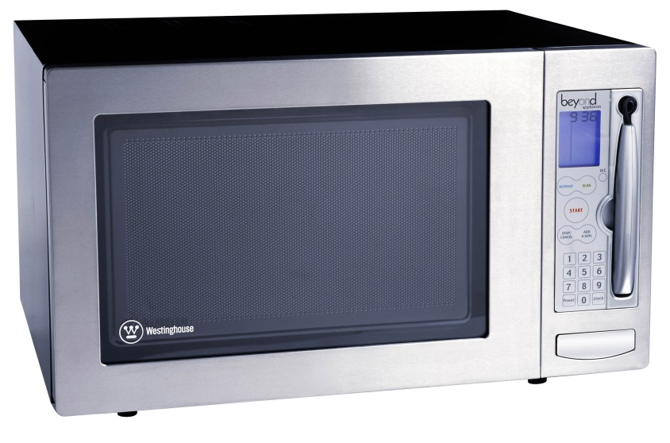

What type of energy cooks food in a microwave oven?
RADIANT ENERGY
What type of energy is the spinning plate inside of a microwave oven?
MECHANICAL ENERGY
Notes:
Instructional Approach(s): The teacher should use the images on the slide to illustrate the difference between radiant energy and mechanical energy.

Slide 20
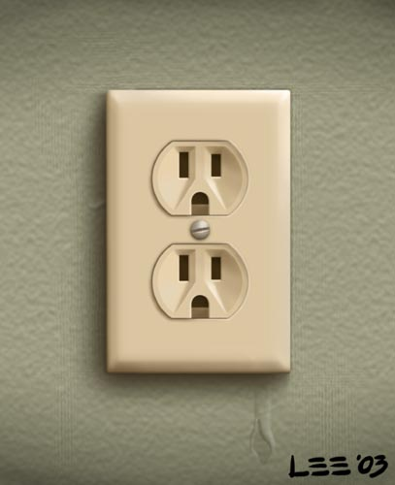
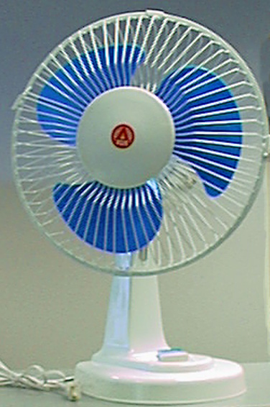
Electrical energy is transported to your house through power lines.
When you plug an electric fan to a power outlet, electrical energy is transformed into what type of energy?
MECHANICAL ENERGY
Notes:
Instructional Approach(s): The teacher should present the animated slide. The teacher should ask the class or call on students to answer the question. Click the mouse to reveal the answer.

Slide 21

What type of energy is shown below?
Chemical Energy
Notes:
Instructional Approach(s): The teacher should present the animated slide. The teacher should ask the class or call on students to answer the question. Click the mouse to reveal the answer.

Slide 22

What types of energy are shown below?
Chemical, Mechanical and
Radiant Energy
Notes:
Instructional Approach(s): The teacher should present the animated slide. The teacher should ask the class or call on students to answer the question. Click the mouse to reveal the answer.

Slide 23
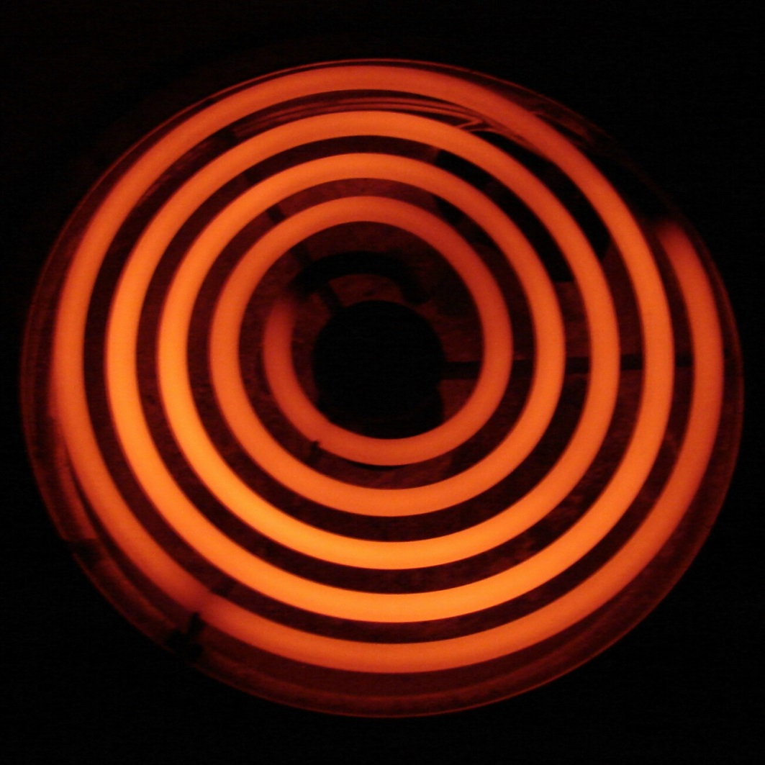
What type of energy is shown below?
Thermal Energy
Notes:
Instructional Approach(s): The teacher should present the animated slide. The teacher should ask the class or call on students to answer the question. Click the mouse to reveal the answer.

Slide 24

What type of energy is shown below?
Chemical Energy (yummy)
Notes:
Instructional Approach(s): The teacher should present the animated slide. The teacher should ask the class or call on students to answer the question. Click the mouse to reveal the answer.

Slide 25
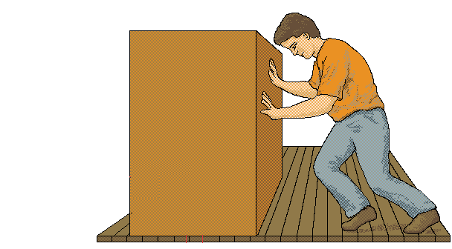
What types of energy are shown below?
Mechanical and Thermal Energy
(Friction causes thermal energy)
Notes:
Instructional Approach(s): The teacher should present the animated slide. The teacher should ask the class or call on students to answer the question.

Slide 26
In the world around you, energy is transforming continually between one form and another.
Often, one form of energy changes into more than one form.
Notes:
Instructional Approach(s): The teacher should present the information on the slide.

Slide 27
According to the Law of Conservation of Energy, energy is never created or destroyed, it just changes its form.
Demonstration of the Law of Conservation of Energy: Exploratorium: Science of Baseball – “Baseketball a Physicist Party Trick”
Notes:
Instructional Approach(s): The teacher should present the information on the slide while the students record the important information on their graphic organizer. The teacher should use the link to demonstrate the size of the law of conservation of energy.

Slide 28
Examples of Transforming Heat (Thermal) Energy
When an object is heated to a high temperature, it glows and gives off heat. Therefore, some thermal energy is converted to light (radiant) energy
A fire or a flame converts heat (thermal) energy to light (radiant) energy
Energy in the form of heat is almost always one of the products of an energy transformation.
For example, when people exercise, when cars run, when a light is turned on, heat is produced.
Notes:
Instructional approach: The teacher should present the information on the slide while the students record the important information on their graphic organizer. The teacher may want to ask students to just pick one or two examples to include on their graphic organizer or shorten the examples to fit.

Slide 29
Examples of Transforming Chemical Energy
Inside your body, chemical energy is transformed into mechanical energy (kinetic energy)
Batteries, wood, matches, fireworks, fossil fuels, etc. are forms of chemical energy that are converted into other forms once used or burned
The matter contained in living organisms has chemical energy. When organisms die, this chemical energy is broken down and converted to other chemical compounds. In this process, thermal energy is released.
Notes:
Instructional approach: The teacher should present the information on the slide while the students record the important information on their graphic organizer. The teacher may want to ask students to just pick one or two examples to include on their graphic organizer or shorten the examples to fit.

Slide 30
Examples of Transforming Light (Radiant) Energy
Plants use light (radiant) energy to make chemical energy. [remember Photosynthesis]
The chemical energy in food is then changed into another kind of chemical energy that your body can use. [remember cellular respiration]
Your body then uses that energy to give you mechanical energy [kinetic and potential energy]
Also, the light (radiant) energy converted into chemical energy in say a tree can then be changed into thermal energy when you burn the tree’s wood.
Notes:
Instructional approach: The teacher should present the information on the slide while the students record the important information on their graphic organizer. The teacher may want to ask students to just pick one or two examples to include on their graphic organizer or shorten the examples to fit.

Slide 31


Examples of Transforming Electrical Energy
Every time you plug something into a wall outlet, you are using electrical energy and that electrical energy is transformed into other forms of energy
Blender:
electrical energy ⇨ mechanical energy
and sound energy
Hairdryer:
electrical energy ⇨ mechanical energy, thermal energy, and sound energy
Alarm Clock: electrical energy ⇨ light energy and sound energy
Notes:
Instructional approach: The teacher should present the information on the slide while the students record the important information on their graphic organizer. The teacher may want to ask students to just pick one or two examples to include on their graphic organizer or shorten the examples to fit. Another example: Electrical energy changes into thermal energy when a wire carrying an electric current gets hot.

Slide 32


Let’s examine the Energy Transformation in riding a bike.
As the rider pedals, her leg muscles transform chemical energy (potential energy stored from the food she ate) into mechanical (kinetic) energy
The mechanical (kinetic) energy of her leg muscles transforms into mechanical (kinetic energy) of the bicycle as she pedals
Some of this energy transforms into potential energy as she moves up the hill
Some energy is transformed into thermal energy (her body is warmer because chemical energy is released and because of friction, the mechanical parts of the bicycle are warmer too)
Notes:
Instructional Approach(s): The teacher should use the image on the slide to illustrate the energy transformation in riding a bike.

Slide 33

Energy Transformations in a Car
A car engine transforms the chemical energy in gasoline into mechanical energy (kinetic and potential energy)
Not all of the chemical energy is converted into mechanical energy. Some is converted into thermal energy, and the engine becomes hot.
The chemical energy in the car battery is also transformed into other forms of energy
Notes:
Instructional Approach(s): The teacher should use the image on the slide to illustrate the energy transformation in a car.

Slide 34
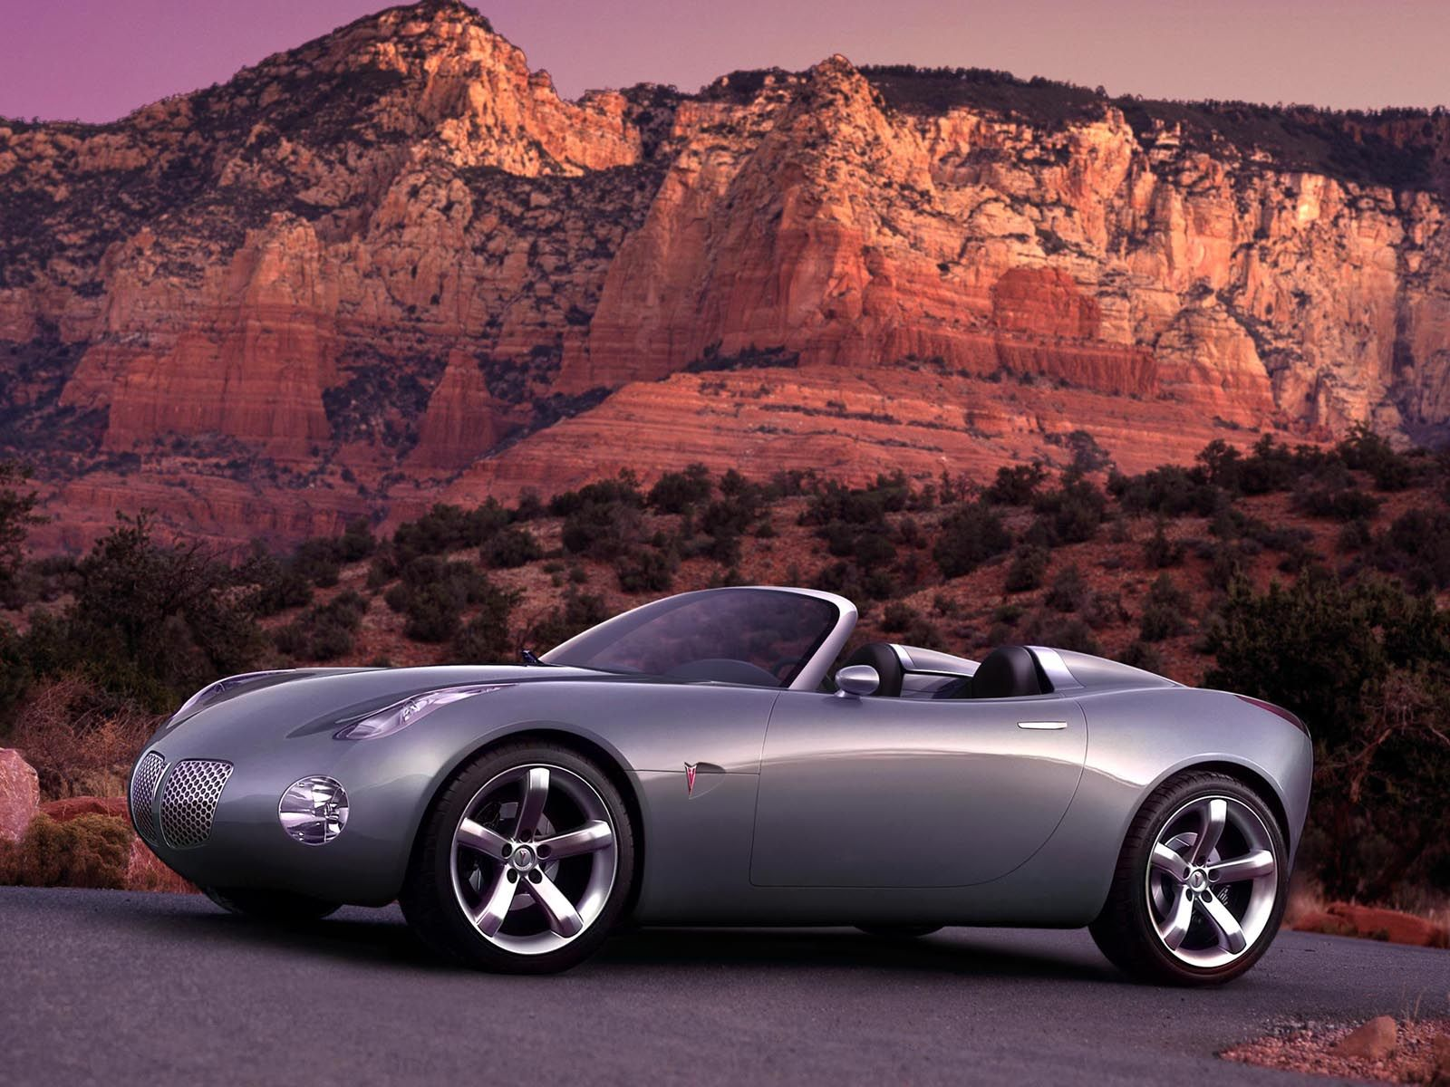

Identify other energy transformations that you can observe in a car.
Notes:
Instructional Approach(s): The teacher should use the image on the slide to illustrate the energy transformation in a car. Allow students time to individually or with a partner discuss additional transformations that occur in a car. After no more than 3 minutes, go to the next slide to see some of the possible responses.

Slide 35
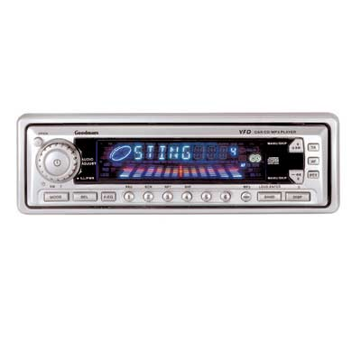

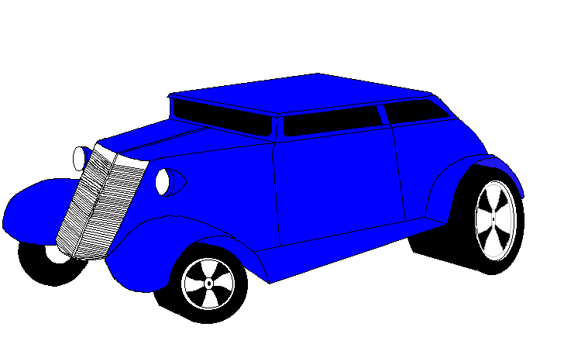

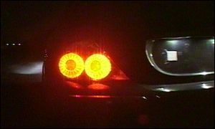
Energy Transfer
Sound
(mechanical)
Electrical
Thermal
Mechanical
Electrical
Chemical
Electrical
Light
(Electromagnetic)
Notes:
Instructional Approach(s): The teacher should use the images on the slide to illustrate the energy transformation in a car after allowing students to discuss them on the previous slide.

Slide 36
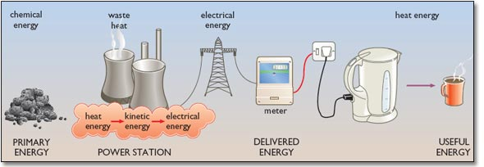
Energy Transformations
Notes:
Instructional Approach(s): The teacher should use the image on the slide to illustrate the energy transformations.

Slide 37
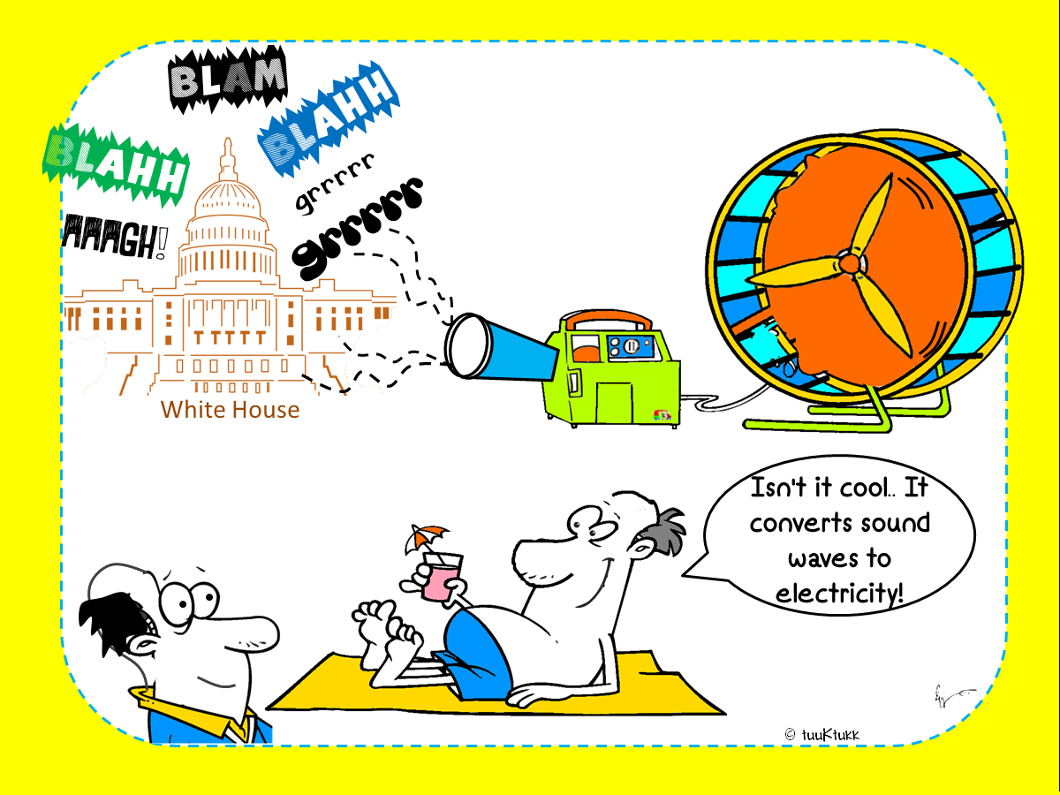
Notes:
Instructional Approach(s): The teacher should use the images on the slide to illustrate the energy transformations.

Slide 38
Watch the short video clip. Identify the energy transformations that occur.
http://www.discovery.com/tv-shows/other-shows/videos/time-warp-lighting-a-match.htm
In the video, chemical energy in the match changes to heat (thermal) energy and light (radiant) energy.
While the match is burning, is the amount of chemical energy in the match the same? Why or Why not?
As the match is burning, the chemical energy is decreasing while the thermal energy and the radiant energy are increasing.
Notes:
Instructional Approach(s): The teacher should present the link. The teacher should ask the class or call on students to answer the question. Click the mouse to reveal the answer.

Slide 39
How is Energy Like Money? Handout
As you discovered in the handout, energy is like money in that it doesn’t go away, it just changes form.
Additionally, the starting twenty dollars was reduced, but all of it was still there just in different places. The same is true for energy.
Notes:
Instructional Approach(s): The teacher can use the How is Energy Like Money? Handout [linked on the resource page] as either a class discussion, individual student work, or partner work. Do not give more than 5-10 minutes for the entire activity. When ready, click the mouse to discuss the answers with the class.

Slide 40
Study Jams Video:
Energy and Matter
http://studyjams.scholastic.com/studyjams/jams/science/matter/energy-and-matter.htm
Notes:
Instructional Approach(s): The teacher should show the video to reinforce the concepts of energy and matter

Slide 41
Let’s see what you know about energy transformations.
The following slides will show an image. Guess the type of energy transformation that occurs in the image.
Notes:
Instructional Approach(s): The teacher should present the information on the slide. Students can work individually or with a partner. However, the teacher should use the activity as a form of formative assessment to determine if students are mastering the concepts of energy transformations.

Slide 42

Identify the Energy
Transformation
Electrical ⇨Sound
Notes:
Instructional Approach(s): The teacher should present the animated slide. The teacher should ask the class or call on students to answer the question. Click the mouse to reveal the answer.

Slide 43

Identify the Energy
Transformation
Light ⇨Chemical
Notes:
Instructional Approach(s): The teacher should present the animated slide. The teacher should ask the class or call on students to answer the question. Click the mouse to reveal the answer.

Slide 44

Identify the Energy
Transformation
Chemical ⇨Mechanical
Notes:
Instructional Approach(s): The teacher should present the animated slide. The teacher should ask the class or call on students to answer the question. Click the mouse to reveal the answer.

Slide 45

Identify the Energy
Transformation
Electrical ⇨ Heat (Thermal)
Notes:
Instructional Approach(s): The teacher should present the animated slide. The teacher should ask the class or call on students to answer the question. Click the mouse to reveal the answer.

Slide 46

Identify the Energy
Transformation
Chemical ⇨Mechanical

Slide 47
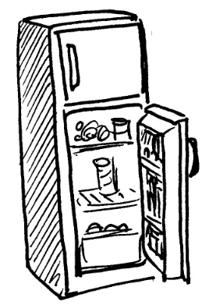
Identify the Energy
Transformation
Electrical ⇨Mechanical and Heat (Thermal)
Notes:
Instructional Approach(s): The teacher should present the animated slide. The teacher should ask the class or call on students to answer the question. Click the mouse to reveal the answer.

Slide 48

Identify the Energy
Transformation
Mechanical ⇨Heat (Thermal)
Notes:
Instructional Approach(s): The teacher should present the animated slide. The teacher should ask the class or call on students to answer the question. Click the mouse to reveal the answer.

Slide 49

Identify the Energy
Transformation
Electrical ⇨Light and Heat (Thermal)
Notes:
Instructional Approach(s): The teacher should present the animated slide. The teacher should ask the class or call on students to answer the question. Click the mouse to reveal the answer.

Slide 50

Identify the Energy
Transformation
Chemical ⇨Light and Heat (Thermal)
Notes:
Instructional Approach(s): The teacher should present the animated slide. The teacher should ask the class or call on students to answer the question. Click the mouse to reveal the answer.

Slide 51

Identify the Energy
Transformation
Light ⇨Electrical and Heat (Thermal)
Notes:
Instructional Approach(s): The teacher should present the animated slide. The teacher should ask the class or call on students to answer the question. Click the mouse to reveal the answer.

Slide 52

Identify the Energy
Transformation
Sound ⇨Electrical ⇨ Sound
Notes:
Instructional Approach(s): The teacher should present the animated slide. The teacher should ask the class or call on students to answer the question. Click the mouse to reveal the answer.

Slide 53
Activities to Reinforce Energy Transformation
Energy Forms and Conversion Worksheet
Energy Transformations [2] Worksheet – see resources for notes
Energy Transformations [3] Worksheet – see resources for notes
Energy Cube Review
How is Energy like Money? Handout
Energy Transformations in a Car constructed response
Station Activities to demonstrate energy transformation
Notes:
Instructional Approach(s): If needed, the teacher can use the additional activities [linked on the energy resource page] to review.

Slide 54
Identify energy transformations in the illustration below. Include the following: Heat, Light, Mechanical, Electrical, Sound, & Chemical
Notes:
Instructional Approach(s): Each student should complete the summarizer. The teacher should use the summarizer to determine the level of student mastery and if differentiation is needed.

