Slide 1

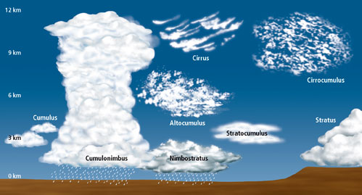

Grade 5
      Big Idea 7: Earth Systems and Patterns
      Weather and Climate
Notes:
SC.5.E.7.3 7.4 7.5.7.6 Weather and Climate power point has been revised and correlated to PSELL Big Idea 7: Earth Systems and Patterns Student booklet for Weather and Climate. The PSELL resources can be found in the Learning Village with the grade 5 science pacing guides.
Open up Discovery Education on your Employee Portal and minimize.
See the last three slides for additional resources.

Slide 2
Big Idea 7: Earth Systems and Patterns
SC.5.E.7.3 - Recognize how air temperature, barometric pressure, humidity, wind speed and direction, and precipitation determine the weather in a particular place and time. AA
SC.5.E.7.4 - Distinguish among the various forms of precipitation (rain, snow, sleet, and hail), making connections to the weather in a particular place and time. (Assessed as SC.5.E.7.3)
SC.5.E.7.5 - Recognize that some of the weather-related differences, such as temperature and humidity, are found among different environments, such as swamps, deserts, and mountains. (Assessed as SC.5.E.7.3)
SC.5.E.7.6 - Describe characteristics (temperature and precipitation) of different climate zones as they relate to latitude, elevation, and proximity to bodies of water. (Assessed as SC.5.E.7.3)
Notes:
Remember to reference targeted benchmarks throughout the lesson.

Slide 3

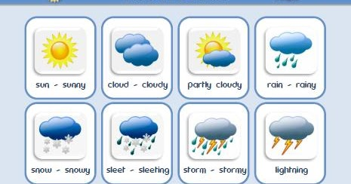
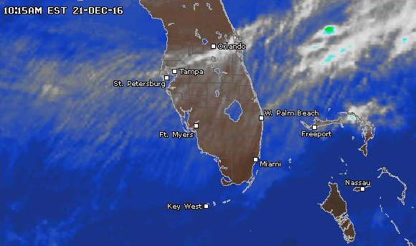
What is WEATHER ?
p. 126
WEATHER is
the mix of events that happen each day in our atmosphere including temperature, rainfall, wind, air pressure, and humidity.
What kind of weather did you observe this week?
Notes:
Engage: What is weather? Discuss. Open the Discovery Education glossary hyperlink WEATHER. Play at the animation and the video. Come up with a definition for weather. Then click on the definition and read from PSELL booklet p. 126 to compare. Students write a weather definition in their notebooks. They can draw some symbols for different types of weather.

Slide 4
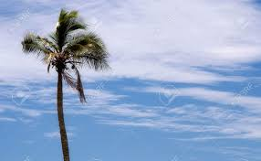

What do you know about Earth’s atmosphere?
Look out a window. What do you see?
You might see blue sky and/or clouds.
At night you might see stars or a full moon.
What you are not seeing, however, is the complexity of our atmosphere.
The atmosphere is a blanket of air that covers and surrounds our planet. Earth's atmosphere makes it possible for life to exist. It contains helpful gases that plants, animals, and people need to live. The atmosphere allows the sun's rays to pass through it and warm everything up, so we are comfortable and plants can grow.
Notes:
Explore/Explain: Ask: What do you know about Earth’s atmosphere ?
Say: Look out a window. What do you see? Continue with the slide content.
Open the Discovery Education glossary hyperlink atmosphere. Play at the animation and the video. Discuss the importance of the atmosphere and that this is where our weather takes place.

Slide 5
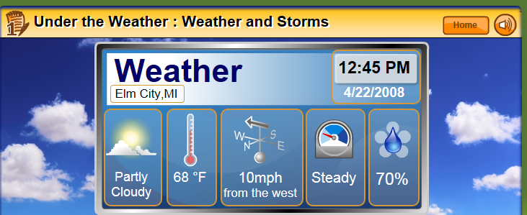
What are Factors Affecting Weather?
p. 127
Air pressure
clouds
humidity
Precipitation
Wind direction
Air temperature
Wind speed
Click here
Notes:
Explore/Explain: Ask: What are Factors Affecting Weather? Have students read PSELL p. 127 and look at the clip art. Students can make a word web for Weather Factors.
Students can explore the Discovery Education Fundamental: Under the Weather: Weather and Storms by clicking on the under the Weather clip art.

Slide 6

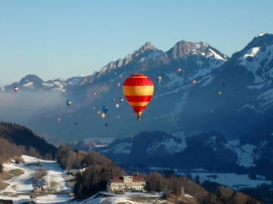
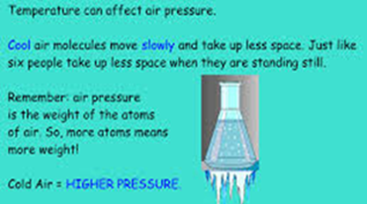
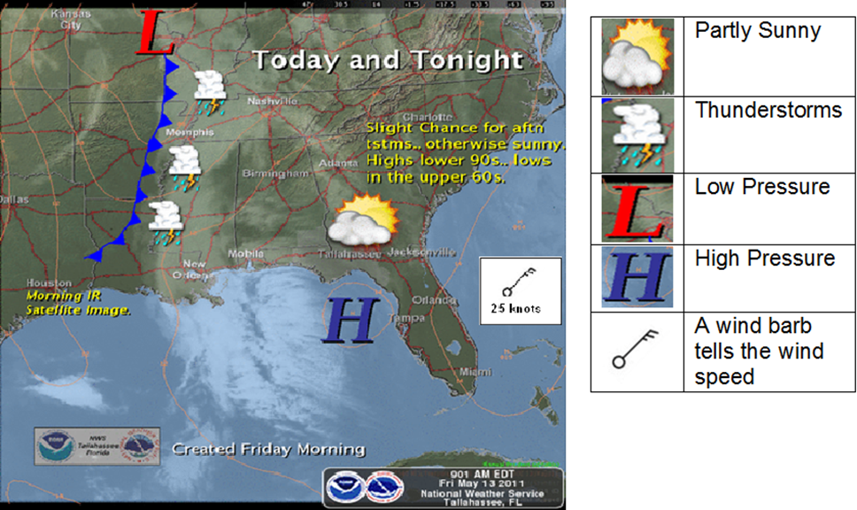
What is air pressure ?
Air pressure is
the weight of air pushing on everything around it.
How do weather conditions affect air pressure? Look at the map.
Cold air = Higher pressure = partly sunny
Warm air = Lower pressure = stormy
p. 127
Notes:
Explore/ Explain: Ask: What is air pressure ? Open the Weather Bug exploration for air pressure. Have volunteer students complete the simulation on the white board.
Open the Discovery Education glossary hyperlink Air pressure . Play at the animation and the video. Come up with a definition for air pressure. Then click on the definition and read from PSELL booklet p. 127 to compare. Students write an air pressure definition in their notebooks. Next ask: How do weather conditions affect air pressure? Look at the map. The L represents low pressure. What weather symbol do you see? (thunderstorms) The H represents high pressure. . What weather symbol do you see? (partly sunny)

Slide 7
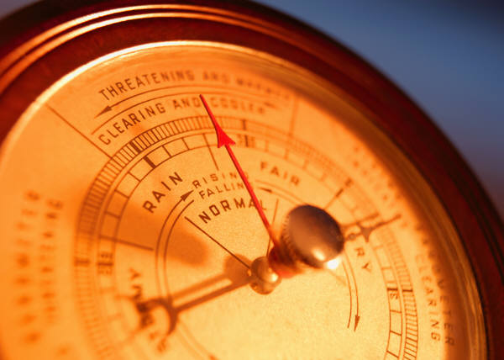
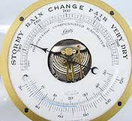
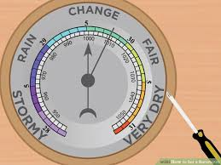
How is air pressure – measured?
A barometer is used to measure air pressure.
Notes:
Explore/Explain: Open the Discovery Education glossary hyperlink air pressure . Play at the animation and the video. Then click on the definition and read from PSELL booklet p. 128 to compare. Answer questions in the booklet.

Slide 8


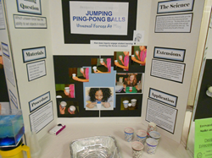
Let’s try an air pressure activity:
A Pressing Engagement
Materials: Ruler; a sheet of printer paper; a sheet of newspaper
Procedures:
Lay a ruler on a table with about 8 cm hanging over the edge.
Lay a sheet of printer paper on the part of the ruler in direct contact with the table.
Press the paper against the table until it is flat as possible.
Press down on part of the ruler hanging over the edge. Observe.
Repeat the above steps except replace the printer paper with a large sheet of opened newspaper in the second step. Observe.
Conclusion: What did you discover?
Which model goes with the printer paper observation?
Which model goes with the newspaper observation?
1.
Elaborate: Explore the Jumping Ping Pong Balls Inquiry. See the Jumping Ping Pong Balls link.
2.
Notes:
Teacher Preparation: Ahead of time go to the link in Let’s try an air pressure activity to preview the lesson.
Explore/Explain: Pass out the materials to each group. Have students follow the procedures.
Conclusion: The students will discover the newspaper was much harder to lift than the printer paper. As the ruler lifted the printer paper, air rush in under the rising paper and thereby quickly allowed the air pressure to equalize on all sides. Essentially, the weight of the air above the paper had no effect on the difficulty in lifting the paper. Model #1.
As the ruler lifted the newspaper, the edges of the newspaper remained in contact with the desk. Very little air was allowed to rush in and equalize the pressure on the bottom side of the newspaper. Since there is less air below the paper the pressure is less as well. Now the weight of all the air above the paper now becomes more evident. Model # 2.
Elaborate: Explore the Jumping Ping Pong Balls Inquiry. See the Jumping Ping Pong Balls Inquiry link.

Slide 9
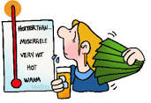
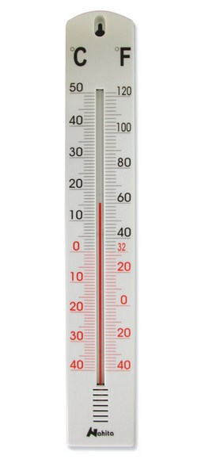
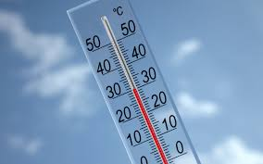
How does Air Temperature influence weather?
p. 128
Air Temperature determines what form of precipitation will fall to the ground.
What is temperature ?
Temperature is the measure of how hot or cold the air is outside.
What tool is used to measure the air temperature?
thermometer
Notes:
Explore/Explain: Ask: How does Air Temperature influence weather? Discuss. Click on the hyperlink in the question. Discuss. Click.
Ask: What is temperature ? Open the Discovery Education glossary hyperlink temperature . Play at the animation and the video. Come up with a definition for temperature . Then click on the definition and read from PSELL booklet p. 128 to compare. Students write temperature definition in their notebooks.
Ask: What tool is used to measure the air temperature? Pass out thermometers and let students read them. They could measure the temperature of warm, room and ice water.

Slide 10
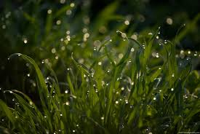
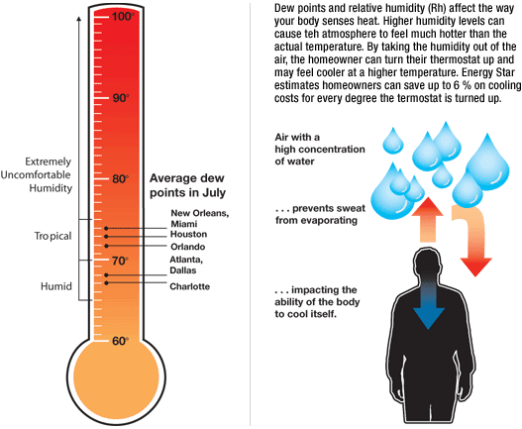
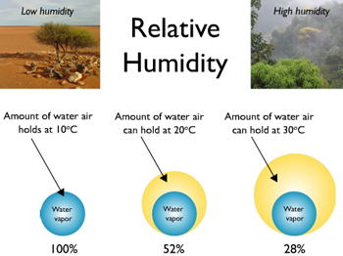
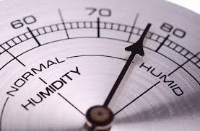
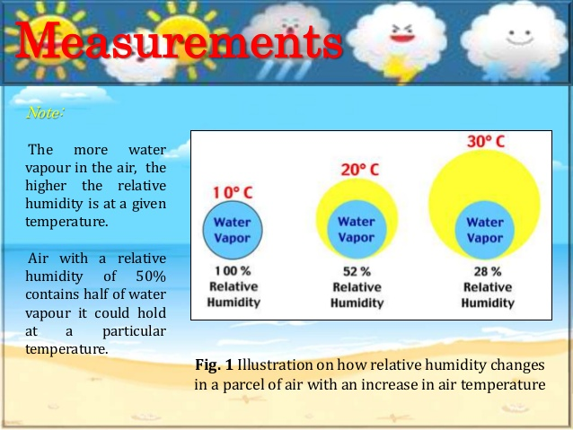
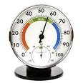
What is Humidity?
p. 128
Humidity is
the measure of how much water vapor is in the air.
It is determined by air temperature.
Warmer air holds more water.
Cooler air holds less water.
What tool is used to measure humidity?
hygrometer
Notes:
Explore: Ask: What is Humidity? Click on this hyperlink. Have students share their experiences with humidity.
Open the Discovery Education glossary hyperlink Humidity is. Play at the animation and the video. Come up with a definition for humidity . Then click on the definition and read from PSELL booklet p. 128 to compare. Students write humidity definition in their notebooks. Discuss what determines humidity. What tool is used to measure humidity? Click on the link for hygrometer. Watch and discuss. Barometer: http://www.sercc.com/education_files/barometer.pdf

Slide 11

What are the basic Clouds ?
p. 129
Cumulus
2. Cirrus
Stratus
fair weather” fluffy, white cotton ball clouds
Feathery like ice clouds
Grayish clouds that can cover the whole sky producing little precipitation
Try You Tube: Cloud in a Jar Experiment
Notes:
Explore: First do SF Gr. 5 p. 216 What is a Cloud? Or the Try You Tube: Cloud in a Jar Experiment Activities
Explain: Ask What are the basic Clouds ? Click on the hyperlink. Discuss the 3 basic clouds and their characteristics.
Ask students what is the fourth type of cloud we will be studying? Cumulonimbus – Ask how it is different from the basic 3 types?

Slide 12

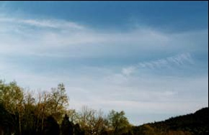
Cirrus Clouds
High Level Clouds
Cirrus clouds are ice clouds.
They can look like delicate white feathers or streamers.
They are always more than three miles up where the temperature is below freezing, even in summer.
Wind currents twist and spread the ice crystals into wispy strands.
Notes:
Elaborate: Click on the hyperlink: Cirrus . Ask what else did you learn about these clouds? Discuss.

Slide 13
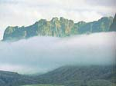
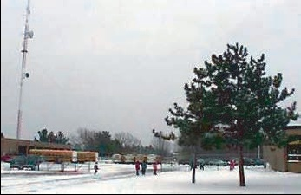
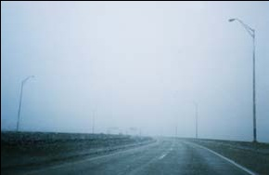
Stratus Clouds
Low Level Clouds
Stratus clouds often look like grayish sheets covering the whole sky.
They seldom produce much rain or snow.
Sometimes, in the mountains or hills, these clouds appear to be fog.
Notes:
Elaborate: Click on the hyperlink: Stratus . Ask what else did you learn about these clouds? Discuss.

Slide 14
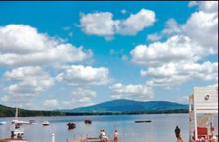

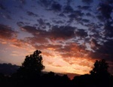
Cumulus Clouds
Mid Level Clouds
Cumulus clouds are the fluffy, white cotton ball or cauliflower-looking clouds with sharp outlines.
They are "fair weather clouds" and they are fun to watch as they grow and change in shape and size.
Cumulus clouds make beautiful sunsets.
Notes:
Elaborate: Click on the hyperlink: Cumulus. Ask what else did you learn about these clouds? Discuss.

Slide 15
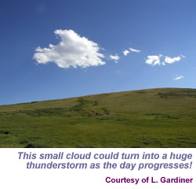
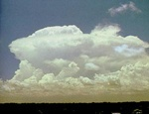
Cumulonimbus
Mid Level Clouds
Cumulonimbus clouds are a sure sign of bad weather to come.
These clouds build up on hot days when warm, wet air rises very high into the sky.
Up and down winds within the cloud may push water droplets up to very cold parts of the atmosphere, where they freeze.
When the ice drops come back down, they get another coating of water and are pushed back up to freeze again. Finally, they get too heavy to stay in the cloud and fall to the Earth as hail.
Notes:
Elaborate: Click on the hyperlink: Cumulonimbus . Ask what else did you learn about these clouds? Discuss.

Slide 16
Clouds in Art Activity Using the S’COOL Cloud Chart
Clouds Type Quiz: Match both Columns
thunderstorm clouds
feathery like ice clouds
a fair weather” fluffy, white cotton ball like clouds
grayish cloud layers that can cover the whole sky producing little precipitation
1. Cumulus
2. Cirrus
3. Stratus
4. Cumulonimbus
Notes:
Evaluate: quiz

Slide 17
Clouds Type Quiz Answers
1. Cumulus
2. Cirrus
3. Stratus
4. Cumulonimbus
C. fair weather” fluffy, white cotton ball clouds
B. ice clouds
D. thin, white clouds that can cover the whole sky producing little precipitation
Thunderstorm clouds
Make a Cloud Finder Activity / cloud classification charts
Notes:
Evaluate: quiz key
Teachers: ahead of time: Open the Make a Cloud Finder Activity and print out the cloud finder activity pages.
Elaborate: click on the Clouds hyperlink and visit the cloud gallery. Then do the
Activity: Make a Cloud Finder.

Slide 18

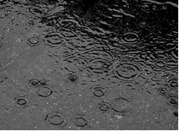
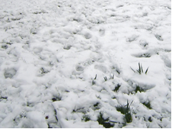
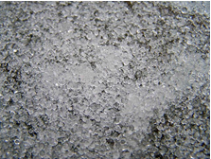
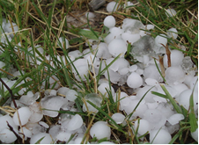
What is Precipitation?
Weather Condition
pp. 130-131
Forms of Precipitation
Rain
Snow
Sleet
Hail
Rain falls when the water making up clouds has become heavy enough to fall to Earth.
Snow form in clouds where the temperature is below freezing as ice crystals or groups of many ice crystals called snowflakes.
Sleet forms when a partially melted snowflake that has traveled through a warm layer of air or raindrop fall through a freezing layer of air. This last layer causes the raindrop to freeze or the melted snowflake to refreeze.
Hail forms as a result of the strong updrafts common in thunderstorms usually in the summer.
Notes:
Explore/Explain: Ask: What is Precipitation? Play the hyperlink and discuss. Open up each of the of the hyperlinks for the 4 types of precipitation. Discuss the description for each. Compare to information in the PSELL Precipitation Chart on p. 130. Discuss weather conditions listed on the slide and in the chart.
Evaluate: Use the information from the videos, the slide and the chart on p. 130 to answer the four questions on p. 131.

Slide 19


Forms of Precipitation
Group Project
Prepare and deliver a 5 minute presentation on the four forms of precipitation: rain, snow, sleet, and hail.
Research and develop an explanation for how each one forms and their related weather conditions.
Be detailed, thorough, and use pictures.
Notes:
Optional Extend/Elaborate: This can be an extension of the CER – How do snowflakes form? This CER investigation is in science.dadeschools.net Elementary Instructional Resources Gr. 5 Quarter 2 for Big Idea 7.

Slide 20


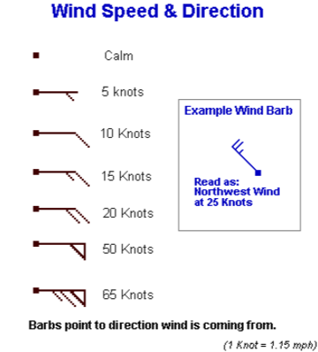
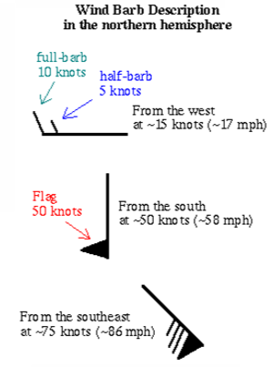
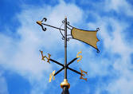
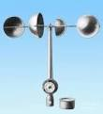
Wind Speed and Direction
What is Wind?
pp. 131-132
Wind is
moving air and is caused by differences in air pressure within our atmosphere. Air under high pressure moves toward areas of low pressure. The greater the difference in pressure, the faster the air flows.
What tools are used to measure wind?
Measuring Wind Direction:
Build a Wind Vane
Measuring Wind Speed:
Build an anemometer
Wind scale
Notes:
Explore/Explain: ask: What is Wind ? Play the hyperlink video on clip. Discuss. Click on hyperlinked passage: Wind is
And use the passage in PSELL p. 131 to get a definition. Ask what tools are used to measure wind? PSELL p. 132.
Elaborate: Preview ahead of time the hyperlinked Explore activities: Build a Wind Vane and Build an anemometer
Wind vane: http://www.ciese.org/curriculum/weatherproj2/en/docs/windvane.shtml

Slide 21

Weather observations & Tools
Observations Try Out:
temperature
amount of precipitation
air pressure
humidity
wind direction
wind speed
cloud conditions including
type and altitude of clouds
Try Out:
Video True/False Quiz: Weather Smart Heat, Wind and Pressure
Tools
thermometer
rain gauge
barometer
hygrometer
wind vane
anemometer & radar
cloud classification charts
Notes:
Evaluate: Quiz
Elaborate: Try Out: Video True/False Quiz: Weather Smart Heat, Wind and Pressure
The Whatdaya Know Quiz Show: Weather
Explore Hands-on: Scholastic Weather Watch:
http://teacher.scholastic.com/activities/wwatch/index.htm

Slide 22

Weather - Tool Match Up
Weather Tool to Use
Weather Observations
1. Temperature
2. Rain Fall
3. Wind Direction
Wind Speed
Air Pressure
6. Cloud Conditions
Wind Vane
B. Thermometer
C. Rain Gauge
D. Barometer
E. Anemometer
F. Cloud Identification Chart
Notes:
Evaluate: quiz match up

Slide 23

Weather - Tool Match Up
Weather Observations
Weather Tool to Use
1. Temperature
2. Rain Fall
3. Wind Direction
Wind Speed
Air Pressure
6. Cloud Conditions
B. Thermometer
C. Rain Gauge
A. Wind Vane
D. Anemometer
E. Barometer
F. Cloud Identification Chart
Notes:
Evaluate: Quiz answer key

Slide 24

What is the difference between weather and climate?
Weather is what is happening each day in our atmosphere including temperature, rainfall, wind, air pressure, and humidity.
Climate is the average weather in an area over a long period of time (more than 30 years). It includes weather conditions, weather extremes, droughts, and rainy periods. The climate of an environment will determine what plants will grow and what animals will inhabit it.
What is our climate in South Florida?
Notes:
Explain: Review the difference between weather and climate.
Elaborate: AIMS Gr. 5 Earth Science Resource: pp. 79-80 Weather and Climate

Slide 25
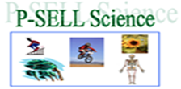
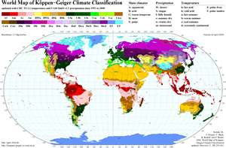

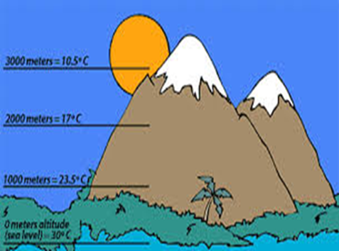
Geographical Factors that Affecting Weather and Climate pp. 132 - 136
Take a look at Climate Zones
What factors do you thinks affect climate?
Notes:
Engage/Explore: Explore the Take a look at Climate Zones site. Ask: What factors do you think affect climate? Click on a DE video clip climate. Discuss.

Slide 26

How can Proximity to Bodies of Water affect a climate?
p. 132
Water temperature rises and falls much more slowly than land or air temperatures.
This is why air at the shore or beach is generally cooler than air over land.
In winter, the water is generally warmer than the air over the land.
The water helps to keep air temperatures from changing a lot over land near the ocean. This makes for mild climates in shore areas.
Areas further inland generally have greater difference in temperature from summer to winter.
Notes:
Explore/Explain: Ask: How can Proximity to water affect a climate? Have students read p. 132 Proximity to Bodies of Water and underline factors listed and use information from the previous video clip on climates. Then discuss with their group and then share out with the whole class. Last compare their factors to those in the slide.

Slide 27
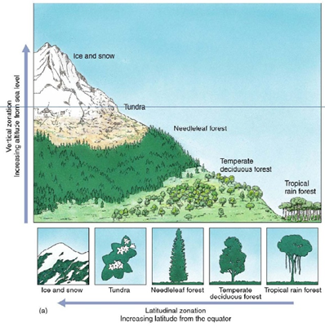

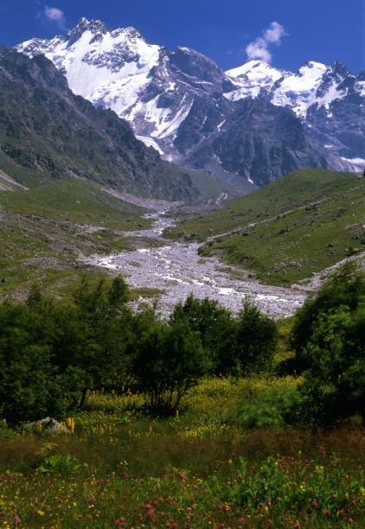
What is
Elevation?
p. 133
Elevation is the distance of a place above sea level.
How does elevation affect an area’s temperature?
  Temperatures generally decrease as elevation increases – about 6.5º Celsius cooler for every kilometer you climb.
  As a result, areas at high elevations, such as tall mountains, are generally cooler than places closer to sea level.
Notes:
Explore/Explain: ask: What is Elevation? Open the Discovery Education glossary hyperlink Elevation . Play at the animation and the video. Come up with a definition for elevation . Then click on the definition and discuss. Students write elevation definition in their notebooks. Students read from PSELL booklet p. 133 to identify how elevation affects an area’s temperature.

Slide 28

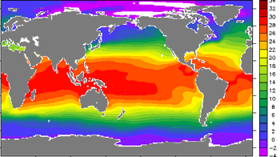

Proximity to the Equator or Latitude
p. 133
How does Latitude or the distance of a place north or south of the equator, affect the temperatures that commonly occur in an area?
As the Sun warms the equator more than the poles, climate varies with Latitude.
Temperatures are generally lower as your get farther from the equator (higher latitudes).
This image shows how sea surface temperatures changes at different latitudes. Red colors indicate warmer ocean water, blues and purples indicate cooler ocean water.
Notes:
Explore/ Explain: Play the Proximity to the Equator or Latitude. Ask What is latitude? (the distance of a place north or south of the equator) Then ask how does latitude affect the temperatures that commonly occur in an area? Then have students read from PSELL booklet p. 133 and study the map to explain how.

Slide 29
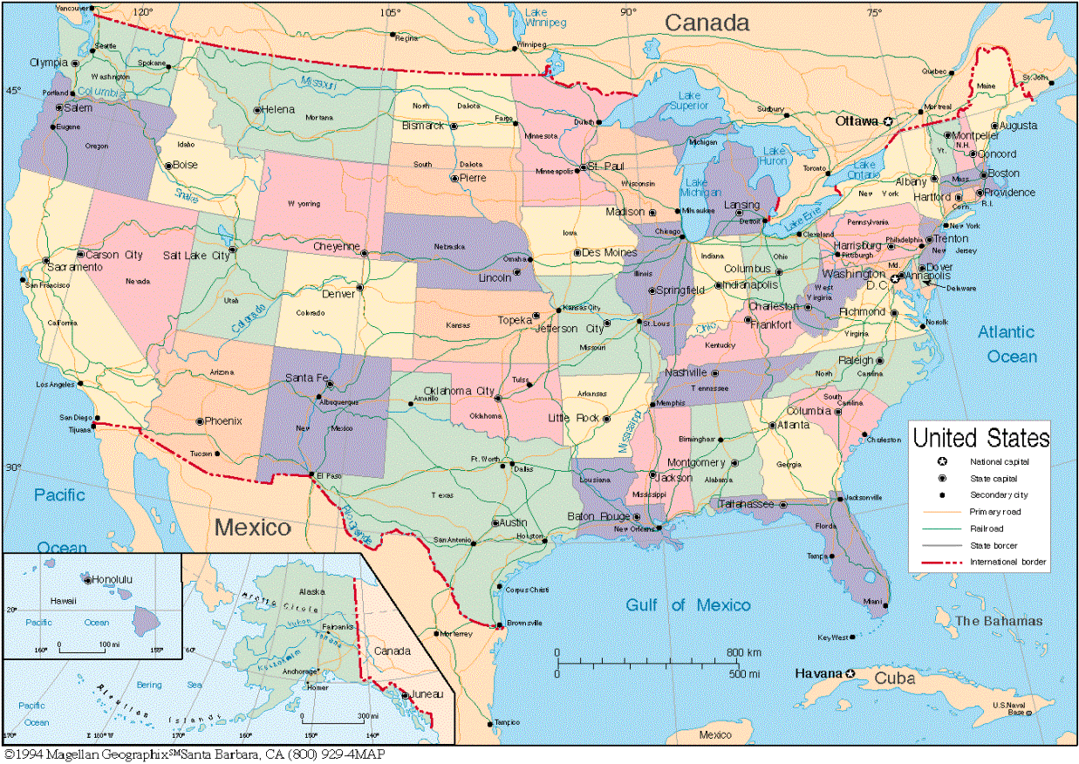
Comparing Climates at the Same Latitude
45°
45°
30°
30°
Typical Winter
San Diego 9º C 48ºF
Phoenix 5º C 41ºF
Typical Summer
San Diego 24º C 75ºF
Phoenix 41º C 106ºF
Notes:
Explore/Explain: have volunteers come up to the white board and find San Diego (latitude 32.71) and
Phoenix (latitude 33.42) on the map. Ask do these cities have the same climate? Look at their typical temperatures in the summer and winter. Are they the same? Why or why not?

Slide 30
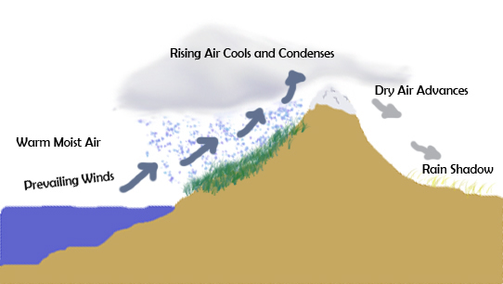
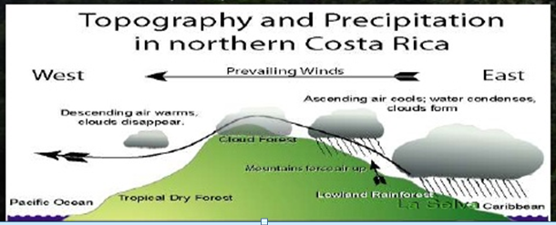
Mountains can also affect the amount of precipitation that an area on either side of a mountain receives called the rain shadow effect.
Notes:
Elaborate/Extend: (optional) Play the hyperlinks and discuss the rain shadow effect.

Slide 31
What is the biggest factor that influences weather and climate worldwide?
Sun
Its heat travels in all directions from the Sun and is the ultimate source of all energy on Earth and our seasons.
Its energy is responsible for all sorts of weather events.
Wind occurs when sunlight heats the ground, which heats the air above it, which rises, so that cool air whisks in to take its place.
The Sun’s Angle on Different Parts of the Earth
Notes:
Explore/Explain: Perhaps the largest influence on our planet’s weather and climate is the Sun because the amount of sunlight a location receives will determine its climate. Additionally, changes in the Sun’s intensity through time and changes in the amount of sunlight let into the Earth system can drastically affect our world’s weather events.

Slide 32
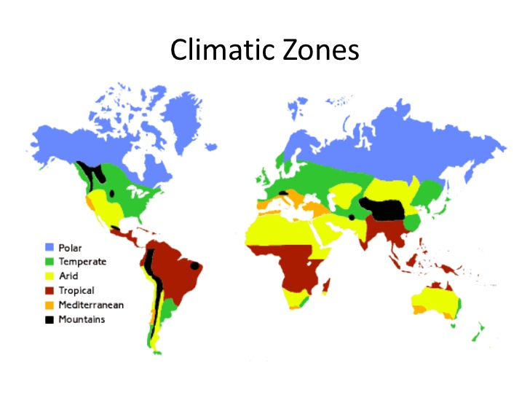
Discovery Exploration: Types of Climates
Notes:
Explore/Explain: Students can do the DE exploration.

Slide 33
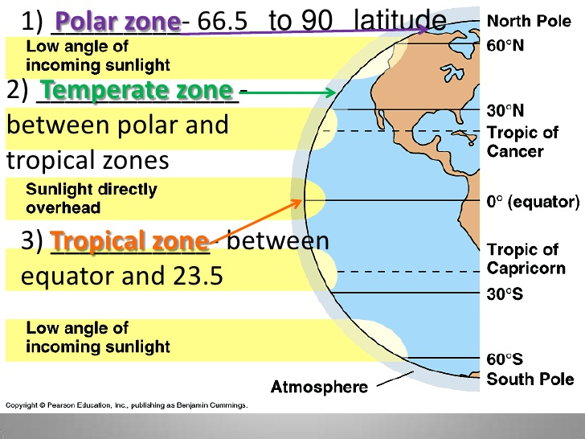
What are the Three Main Climate Zones?
ScienceSaurus Handbook p. 216
p. 134
Notes:
Explore/Explain: Ask: What are the Three Main Climate Zones? Click on the hyperlink Climate Zones and play. Discuss. Students read PSELL p. 134 and underline key facts about each of the climate zones.

Slide 34
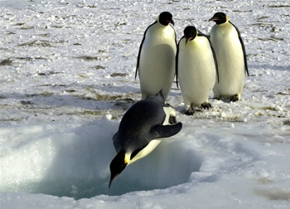
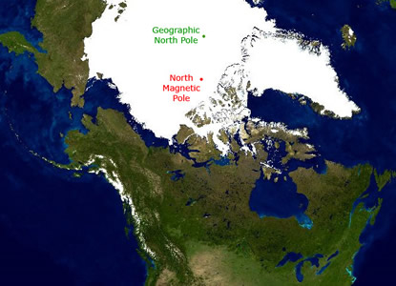
Polar Climates
Polar climates are cold and dry, with long, dark winters.
Average monthly temperature is below freezing (0° C, 32° F) for 8 to 10 months.
Maximum summer temperature is no more than 10 °C (42° F) .
There are short burst of vegetation when snow melts that includes lichen, moss, some flowering plants.
There are no trees.
Notes:
Elaborate: Click on the hyperlink: Polar Climates . Ask what else did you learn about these climate zones? Discuss.
Students can make a Climate foldable comparing the three climates.

Slide 35


Temperate Climates
Temperate climates have warm summers and cool winters with year-round rain or snow.
Temperate forests are characterized by deciduous trees, which lose their leaves during the winter.
Notes:
Elaborate: Click on the hyperlink: Temperate Climates . Ask what else did you learn about these climate zones? Discuss.
Students can make a Climate foldable comparing the three climates.

Slide 36


Tropical Climates
Tropical rainforests are found in regions near the equator. Here, the climate is hot and wet all year, with temperatures remaining at around 80–82ºF (27–28ºC).
Rainforests: As the name suggests, rainforests receive a lot of rain. The temperature stays warm in the rainforest all year long.
Notes:
Elaborate: Click on the hyperlink: Tropical Climates . Ask what else did you learn about these climate zones? Discuss.
Students can make a Climate foldable comparing the three climates.

Slide 37

Climate Zones
Climate Conditions
Climate
Polar
Temperate
Tropical
hot and wet all year
very cold and dry all year
mild to cold winters and mild to dry hot summers
Notes:
Evaluate: Quiz

Slide 38
Concept Review: Climate
Why are climates different in different regions of the world?
Climate depends on three factors:
The region’s nearness to bodies of water - If a region is near a large body of water, sometimes the climate is more moist and cooler.
The elevation of the land - If a region is near a mountain range, sometimes the climate on one side of the mountain is different than the climate on the other side of the mountain.
The way the sun hits the region of Earth - The way the sun hits the Earth’s region determines its weather and climate. Near the equator, the sun hits the Earth directly. This makes climates near the equator warm. The sun hits the Earth less directly north and south of the equator. Climates north and south of the equator tend to be cooler.
Notes:
Evaluate: HOTS Questions with short responses.

Slide 39
Concept Review: Types of Climates
What characterizes a polar climate?
Answer: Polar climates have cold temperatures. They can be either snowy or very dry.
2. What characterizes a tropical climate?
Answer: A tropical climate is warm, and has wet air and a lot of precipitation.
3. What characterizes a temperate climate?
Answer: A temperate climate has moderate precipitation and has a range of temperatures.
Notes:
Evaluate: HOTS Questions with short responses.

Slide 40





How Do Different Environments’ Climate Differ?
Use as a resource for PSELL Climate Activity: Climate Zones pp. 134-136
Environment | High Temperature | Low Temperature | Precipitation
Desert | 113 °F (45 °C) | 32 °F (0 °C) | Very dry - receives less than 25 cm (16 in) of rain each year
Tundra | Summer 45 - 50°F | Winter - 20 - 30 ° F (-29 -34 ° C) | 30 to 85 cm
Temperate Grassland | Summer can be well over 38°C (100° F) | Winter can be as low as -40° C (-40° F) | 50.8 to 88.9 cm (20-35 inches) More rain than deserts, less rain than forests
Tropical Rainforest | 80–82ºF (27–28ºC) |  | Very wet – receives 120 to 650 cm (50- 260 in) of rain each year
Notes:
Explain/Evaluate: PSELL Climate Activity: Climate Zones pp. 134-136

Slide 41

Big Idea 7 Earth Systems & Patterns Games
http://www.cotf.edu/ete/modules/k4/swf/Wonline1.swf
The Whatdaya Know Quiz Show: Weather
Earth Systems and Patterns Jeopardy Grade 5 Quarter 2
Notes:
Evaluate/Elaborate

Slide 42
Sample FCAT 2.0 Question SC.E.5.7.3
Florida Achieves
Which answer correctly explains the difference between sleet and hail?
Sleet is usually part of a thunderstorm, and hail comes from thin layers of rain clouds.
Sleet is smaller than hail and usually falls in the winter, while hail usually falls in the summer.
Sleet and hail are the same except that sleet usually falls in summer and hail usually falls in winter.
Sleet is snow that forms as it falls through cold air, and hail is rain that freezes when it hits the ground.
Notes:
Evaluate: Florida Achieves sample questions.

Slide 43
Sample FCAT 2.0 Question SC.E.5.7.3
Florida Achieves
2) As the weather gets colder, the air pressure usually goes up. Why does this happen?
As the temperature drops, the air takes up more space and presses down harder on the ground.
Colder weather makes the air denser, and the increased weight of the air means that there is more air pressure.
Cold weather causes Earth to cool, and the heat that leaves Earth pushes against the air and increases pressure.
When the weather is colder, the clouds weigh more as ice begins to form. The heavier clouds increase the air pressure.
Notes:
Evaluate: Florida Achieves sample questions.

Slide 44
Sample FCAT 2.0 Question SC.E.5.7.3
Florida Achieves
3) Which answer choice correctly lists
environments from most dry to least dry?
desert, tundra, grassland, rainforest
grassland, rainforest, desert, tundra
tundra, rainforest, grassland, desert
rainforest, grassland, tundra, desert
Notes:
Evaluate: Florida Achieves sample questions.

Slide 45
Sample FCAT 2.0 Question SC.E.5.7.3
Florida Achieves
4) Which answer choice lists the weather
conditions that would most likely result in snow?
warm temperature, light winds, low humidity
low humidity, freezing temperature, light clouds
freezing temperature, light clouds, heavy winds
freezing temperature, heavy clouds, high humidity
Notes:
Evaluate: Florida Achieves sample questions.

Slide 46
Sample FCAT 2.0 Question SC.E.5.7.1
Florida Achieves
5) Water runs down creeks and rivers until it flows into the ocean. At what stage in the water cycle does the water return to the creeks and rivers?
condensation
evaporation
precipitation
vapor formation
Notes:
Evaluate: Florida Achieves sample questions.

Slide 47
Sample FCAT 2.0 Question SC.E.5.7.1
Florida Achieves
6) Which of the following best describes what clouds are made of?
fog that has risen from the ground
large amounts of water that has evaporated
water vapor that has condensed into droplets
rain or snow that has been pushed together by wind
Notes:
Evaluate: Florida Achieves sample questions.

Slide 48
Sample FCAT 2.0 Question SC.E.5.7.1
Florida Achieves
7) Which answer best explains why clouds usually form high in the sky?
It is cold enough there for the water vapor to begin condensing.
It is warm enough there for evaporated water to expand into clouds.
It is dry enough there for precipitation to form from condensed water vapor.
It is windy enough there for water droplets to get pushed together into clouds.
Notes:
Evaluate: Florida Achieves sample questions.

Slide 49
Sample FCAT 2.0 Question SC.E.5.7.1
Florida Achieves
8) Hurricanes generally produce a great deal of precipitation. Where do these storms collect the moisture needed to produce so much precipitation?
from water evaporating quickly off the warm ocean surface
from the energy of ocean currents moving water into the air
from cold ocean water meeting warm land and producing clouds
from rain condensing as the hurricane passes over high mountains
Notes:
Evaluate: Florida Achieves sample questions.

Slide 50
Weather & Climate Resources
Videos:
http://videoclips.mrdonn.org/weather.html
http://www.teachersdomain.org/asset/idptv11_vid_d4kwea/
http://video.nationalgeographic.com/video/science/earth-sci/climate-weather-sci/
http://video.nationalgeographic.com/video/kids/forces-of-nature-kids/weather-101-kids/
http://www.sciencekids.co.nz/videos/weather/clouds.html
http://weatherthings.com/TeacherVideos.html
Air pressure act:
http://www.srh.noaa.gov/jetstream/atmos/ll_engagement.htm
http://www.sercc.com/education_files/aer_fall_01.pdf
NASA Our World:
http://www.nasa.gov/audience/foreducators/nasaeclips/search.html?terms=What%20is%20weather%3F&category=1000&disp=grid
Weather Quizzes:
Weather quiz: http://www.neok12.com/quiz/SEASON04
Instruments quiz: http://www.neok12.com/quiz/SEASON03

Slide 51
Making Weather Instruments Resources
Weather Stations:
http://teacher.scholastic.com/activities/wwatch/index.htm
Barometer:
http://www.sercc.com/education_files/barometer.pdf
http://homepage.eircom.net/~kogrange/6th_ys_2009_pressure7_barometer.html
Wind vane: http://www.ciese.org/curriculum/weatherproj2/en/docs/windvane.shtml
Wind scale: http://www.wrh.noaa.gov/sto/WindTable.php
Finding Cloud Charts: http://scool.larc.nasa.gov/

Slide 52
Weather Sites for Kids
http://www.edheads.org/activities/weather/index.shtml
http://weather.weatherbug.com/weather-education/exploration_zone.asp?focus=2
http://weatherwizkids.com/
http://scijinks.jpl.nasa.gov/weather-menu
http://www.eo.ucar.edu/webweather/
http://www.bbc.co.uk/schools/whatisweather/
http://www.scilinks.org/Harcourt_Hsp/HspStudentRetrieve.aspx?Code=HSP103
http://www.internet4classrooms.com/science_elem_weather.htm
http://www.fi.edu/weatherED/

Slide 53
Discovery Education Resources
Exploration: Types of Climates
Reading Passage: A Trip Through Two Climate Zones
eBook: A Trip to the Tropics

